Slide 1
Urban Agenda Partnership on Circular Economy
6th April, 2018
Håkon Jentoft, Coordinator

Slide 2

What is Urban Agenda for the EU?
Joint effort to strengthen the urban dimension in EU policy making
70 per cent of EU population live in Urban areas
Make European regulation and resources more adapted to the cities
Notes:
The European Urban Agenda is a joint effort of European Commission, Member States and European Cities Networks to strengthen the recognition of the urban dimension by European and national policy actors.
The EU want to offer cities a European stage, make European regulations and resources more workable and improve knowledge-sharing between European cities.
The European Union has no formal authority over urban policy. Nonetheless, there are three tracks through which the EU can foster the development of European cities:

Slide 3
Three dimensions
Improve regulations
Create more workable financial instruments
  Create European platforms for urban inspiration and knowledge sharing
Notes:
Improve regulation.
Create more workable financial instruments.
Create a European platform for urban imagination and knowledge
This could be done on EU, member state and city level. However, the main focus will be on the EU level.
European platforms for knowledge and inspiration could be developed in several different manners. This depends on the item of the partnerships.

Slide 4
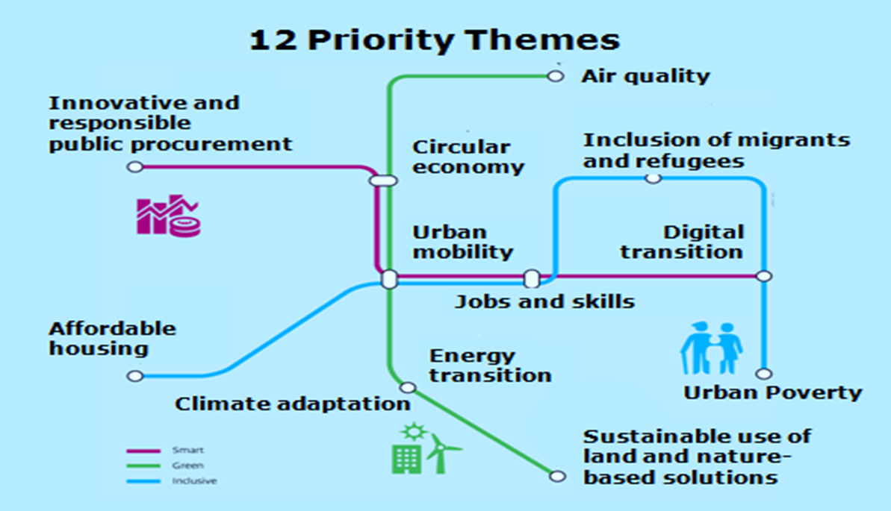
Notes:
This map shows the 12 different partnerships in the Urban Agenda, illustrated as a sub-way map.
The green line shows partnerships dedicated to making cities more “Green”. The blue line shows partnerships dedicated to making cities more “Inclusive”, and the third line shows partnership that work with “Smart” cities. Some of the partnership work with several of this topics, among other our partnership. The partnership on Circular Economy both work to make cities both greener and smarter.
The Urban Agenda and has identified 12 priority themes to work on for the first period. Many of these themes are linked to each other. The partnerships for the different themes have a different timeframe, depending on the rescission of start up. Circular Economy is in the second heat, started up January 2017.

Slide 5
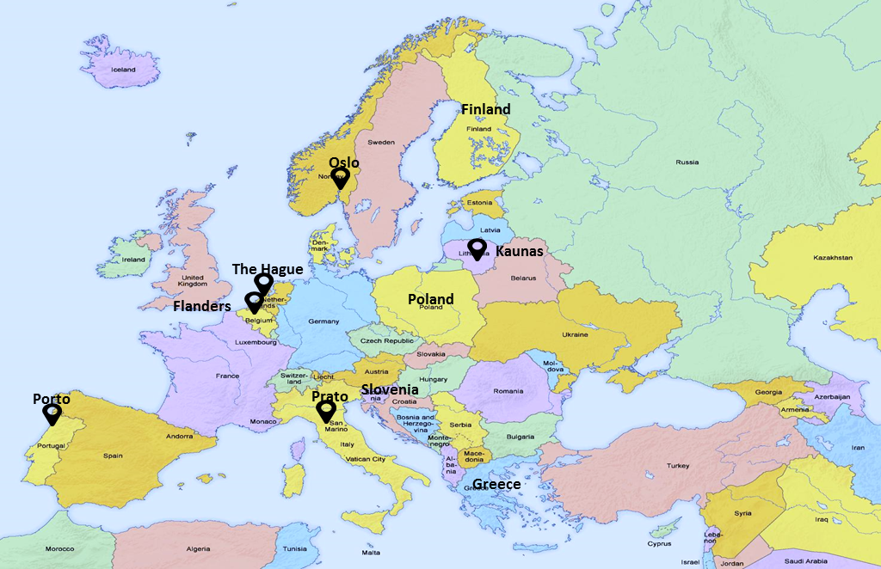
Partners Circular Economy
Commission representatives of the relevant DGs
EC - DG REGIO
EC - DG ENV
EC - DG CLIMA
EC - DG GROWTH
EC – DG RTD
Urban Authorities European associations
EUROCITIES
CEMR (Confederation of European Municipalities and Regions)
Managing Authorities of ESIF (European Structural & Investment Funds)
EIB (European Investment Bank)
ACR+ (Association of Cities and Regions)
URBACT (European exchange and learning programme promoting sustainable urban development)
Experts (e.g., Universities etc.)
Notes:
In the partnership we have six urban authorities:
Oslo (coordinator)
The Hague
Prato
Porto
Kaunas
Flanders
…two of their European associations
EUROCITIES
CEMR (Confederation of European Municipalities and Regions)
Four Member States are represented
Finland
Poland
Slovenia
Greece
And Commission representatives from the relevant DGs
EC - DG REGIO (regional)
EC - DG ENV (Environment)
EC - DG CLIMA (Climate)
EC - DG AGRI (Agriculture)
Furthermore, we have some observers
Managing Authorities of ESIF (European Structural & Investment Funds)
EIB (European Investment Bank)
URBACT; is a European exchange and learning programme promoting sustainable urban development
ACR+ Association of cities and regions
Experts (e.g., Universities etc.)
The City of Oslo is honored to be trusted with the coordination of the work of the Partnership.

Slide 6
Timeframe
2017
Stocktaking
Identifying bottlenecks and possible actions
2018
Draft Action Plan
2019
Implementation of the Action Plan
Final Action Plan
Evaluation of the Partnership
Develop scoping fiches based on the topics chosen
Public consultation and feedback

Slide 7

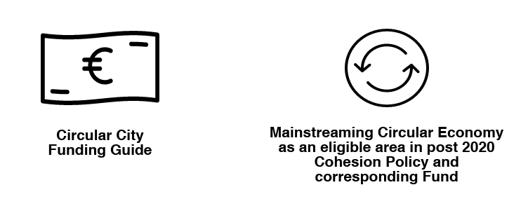
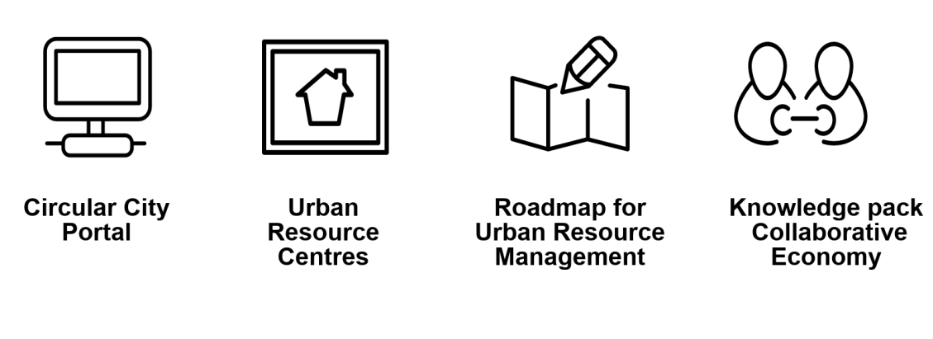
Draft Action plan, part I
Better Regulation
Better Funding
Better Knowledge

Slide 8

Action:
Prepare a blueprint for a Circular City Portal
Prepare a central point of access to information dedicated to the promotion of circular economy in cities
Online platform providing a point of entry for additional information on the subject
Facilitate for the sharing and development of information, tools, guidance and know-how between cities
‘Do-it-yourself’-guidance

Slide 9

Action:
Develop a Collaborative Economy Knowledge Pack for cities
Initiate a field research on the different typologies of Collaborative Economy and circular initiatives
Assessment of the typology of collaborative circular initiatives in five EU cities
Co-create collaborative conference and disseminate findings
Communication and implementation of findings

Slide 10
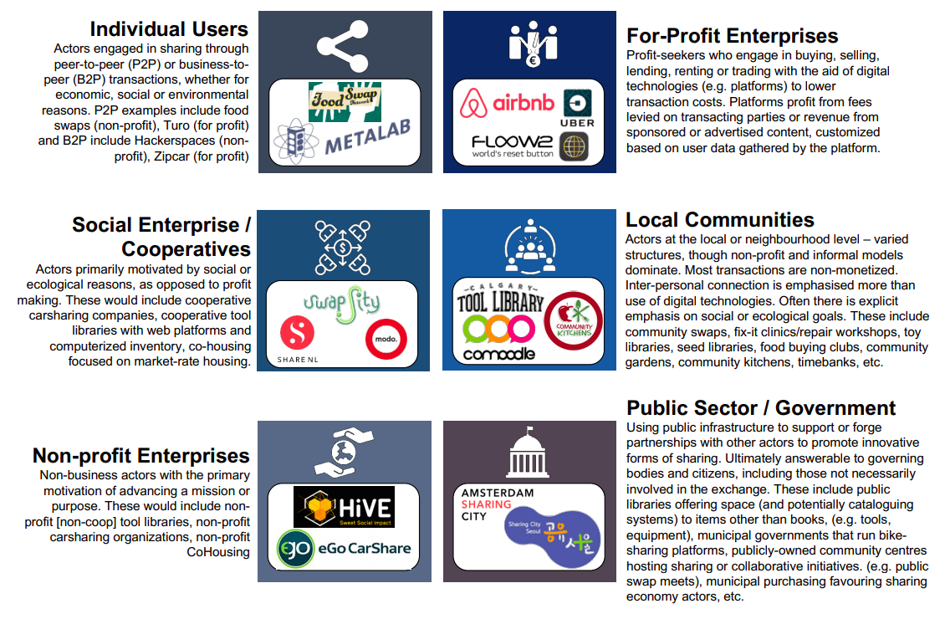
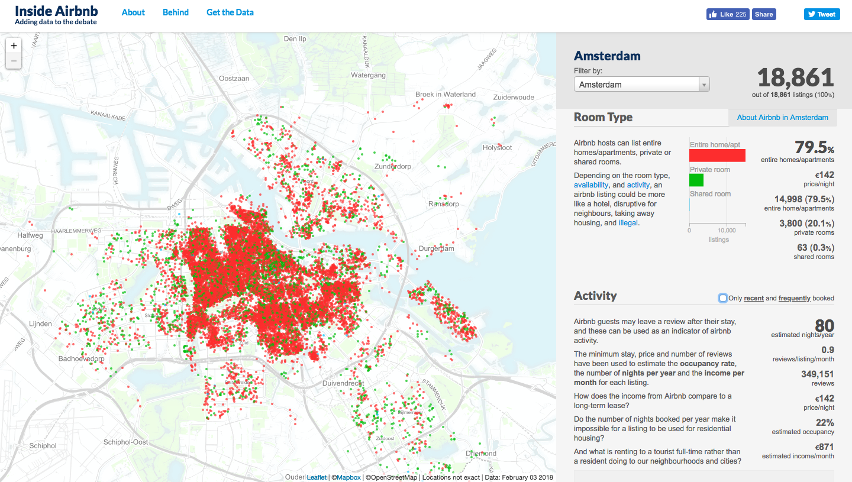

Slide 11
















centralized
global
Centralized & for profit sharing platforms
Global & for benefit: global commons
for profit
for benefit
Distributed & for profit sharing platforms
Local & for benefit: local resilience actions
decentralized
local

Slide 12
Your thoughts……….
on developing a circular city portal that will be used…….
on further developing a collaborative economy knowledge pack for cities……

Slide 13
Thank you for your attention!
Håkon Jentoft, Coordinator
City of Oslo

