Slide 1

EU urban air quality partnership
European Week of Regions and Cities
Awareness raising and knowledge sharing –
Toolkit on communicating on air quality and health
Anne Stauffer, HEAL
https://ec.europa.eu/futurium/en/air-quality/

Slide 2
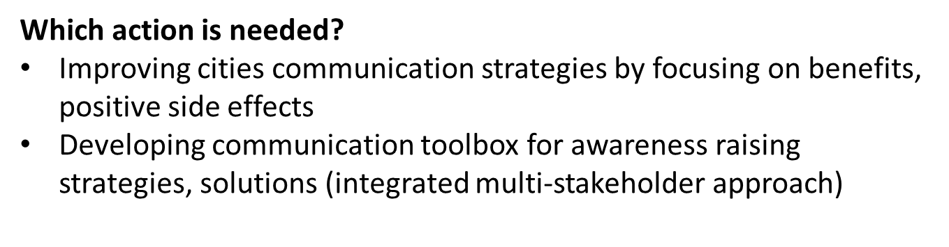
Action no 5
What is the specific problem?
General public little engaged in air quality policy initiatives, knowledge not widely available; also low appreciation of measures
Could be alleviated by sharing examples of successful measures to trigger participation and coproduce solutions
Increased public awareness about air quality&health essential for support on management measures

Slide 3

Toolkit
Based on information from partners, and survey for local authorities
Survey: 10 questions on how urban authorities communicate
Inspiring examples, challenges and stumbling blocks, lessons learnt
Cities from: BE, BG, HR, CZ, FI, FR, DE, IT, LT, NL, RO, SE, UK, PL
https://ec.europa.eu/futurium/en/air-quality
Snapshot of how communication takes place
Not comprehensive assessment, nor ranking
Mix of activities from requirements under the law to messaging and evaluation

Slide 4

Hands on section

Slide 5

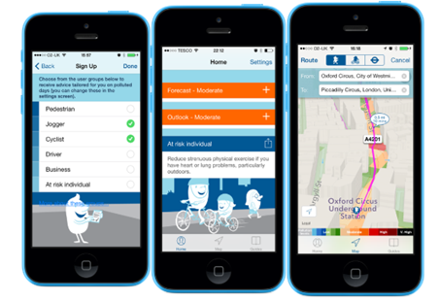
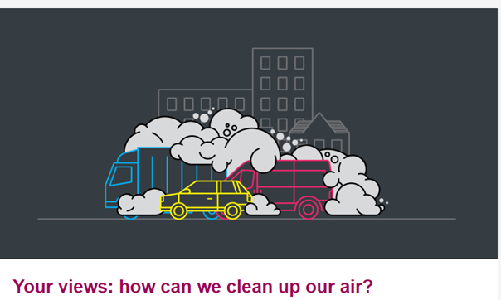
Selected examples: London
https://www.london.gov.uk/what-we-do/environment/pollution-and-air-quality/clean-air-route-finder
https://www.london.gov.uk/what-we-do/environment/pollution-and-air-quality/your-views-how-can-we-clean-our-air
https://www.london.gov.uk/what-we-do/environment/pollution-and-air-quality/health-and-exposure-pollution

Slide 6
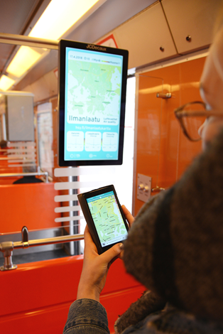
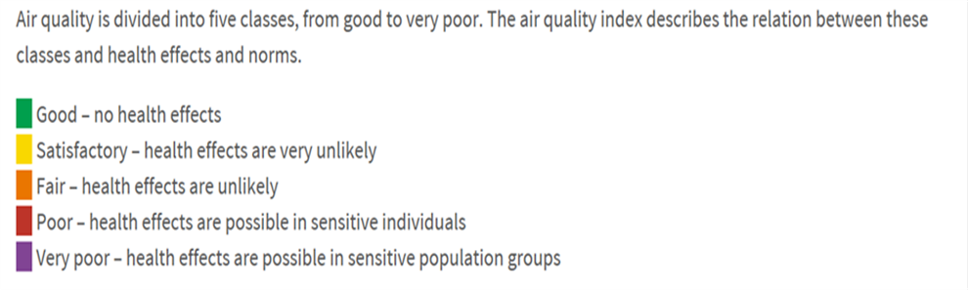
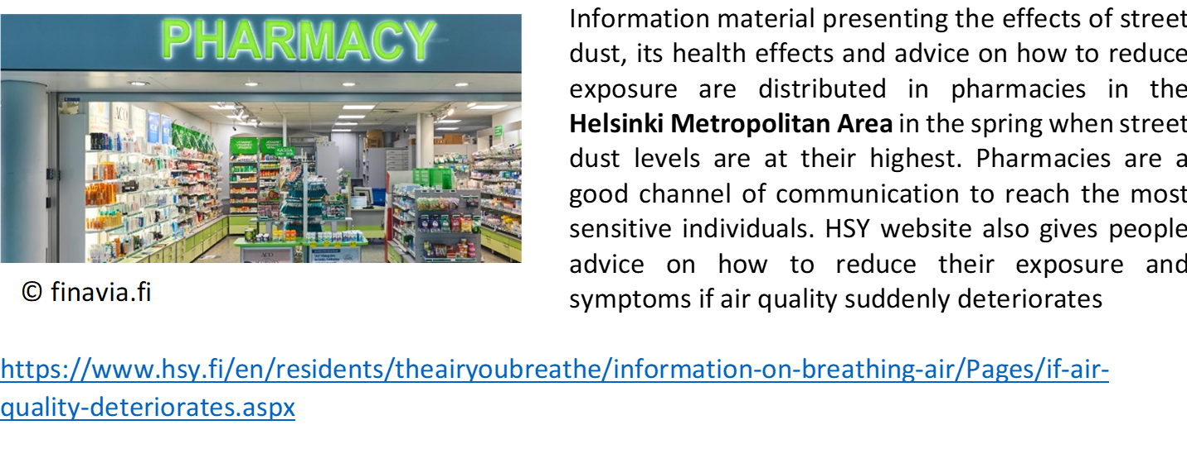
Selected examples: Helsinki
Air quality map
of the Helsinki Metropolitan area

Slide 7
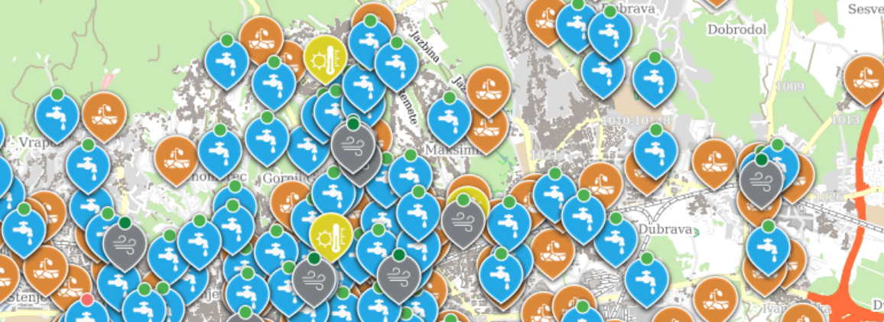
Selected examples: Zagreb
In cooperation with the Institute of Public Health Dr. Andrija Štampar, develops the ZAGREB ECOLOGICAL MAP. It is an innovative program of the City of Zagreb, which aims is to unify many existing environmental monitoring data, networking of all city offices and competent institutions and informing citizens. The Eco Map provides an overview of updated data on water consumption for human consumption, urban areas of the city, soil of city gardens, weather data, pollen allergen data and air quality data in real time (on line) from eight locations in the City of Zagreb. Link:
https://ekokartazagreb.stampar.hr/

Slide 8
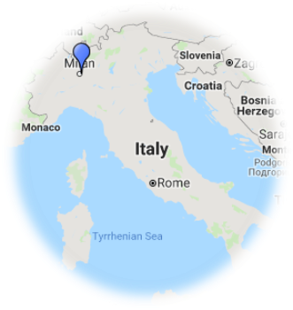


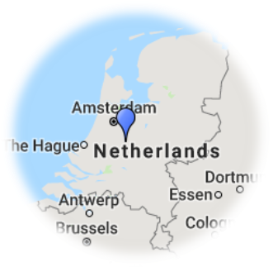
Highlighting behavior change
Milan:
Website of congestion charge with monitoring
black carbon monitoring campaign were presented
at public conferences and events
Utrecht:
Promoting the use of bicycles

Slide 9
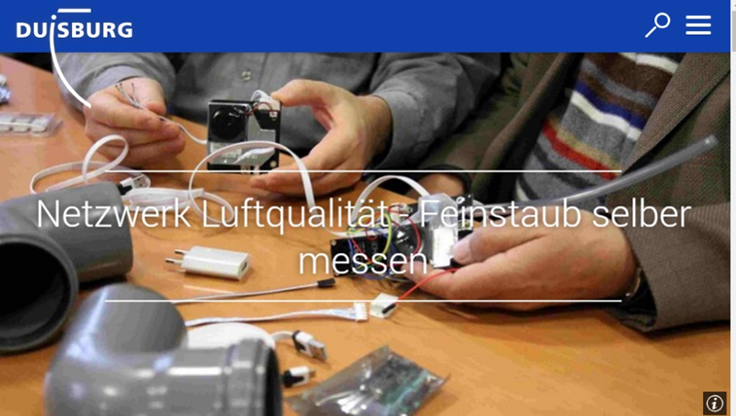
Involving residents in air quality efforts
At the end of 2017, the city of Duisburg, Germany launched its network air quality, a citizens’ science project:
7 professional monitoring stations, run by the state agency of nature, environment and consumer protection, covering an area of 233 square kilometres.
City officials stated that this monitoring only gives a rough picture of the exposure to air pollution, and thus invited residents to build their own monitors to measure particulate matter.
The city offers special workshops on how to assembly the air monitors. The data is then feed into the website luftdaten.info, initiated by Ok Lab Stuttgart.
Other citizens science projects in:
Utrecht, Rennes, Zaandstad, Amersfoort, Leerdam, Alkmaar…
https://www.duisburg.de/allgemein/fachbereiche/31/netzwerk-luftqualitaet.php

Slide 10
Involving residents in air quality efforts

Slide 11

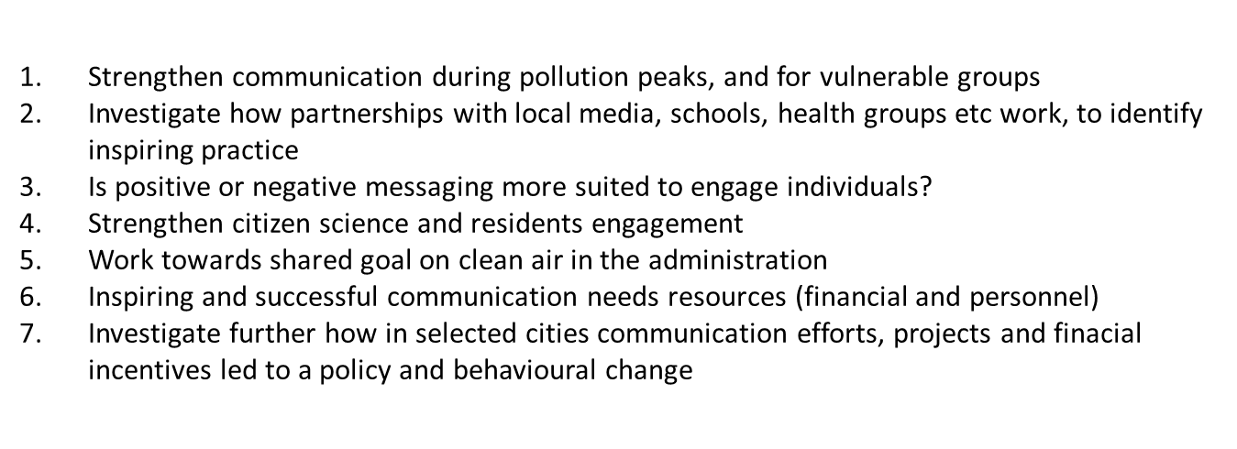
Challenges and lessons learnt
Awareness by individuals / behaviour change:
Lack of interest, refusal to change behaviour,
Inequalities hamper change, misinformation
Finance, governance and policy challenges:
Lack of budget, lack of well trained staff
Lack of cooperation between municipial departments

Slide 12

Health & Environment Alliance (HEAL)
Anne Stauffer
Director for Strategy and Campaigns
Thank you for your attention!
28 Boulevard Charlemagne
B-1000 Brussels Belgium
Tel: + 32 2 234 3640 (main)
www.env-health.org
anne@env-health.org
Notes:
12

