Slide 1



Financing the implementation of
Air quality plans
Partnership for Air Quality Meeting
9th October, Brussels

Slide 2
Air Quality in Milan &
Air Quality Plan development

Slide 3


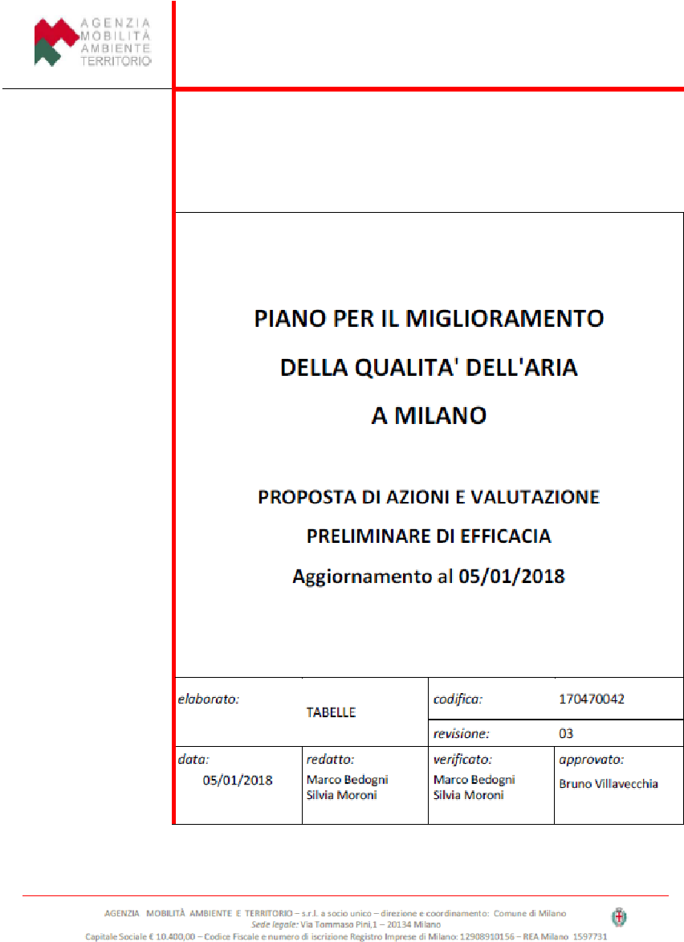
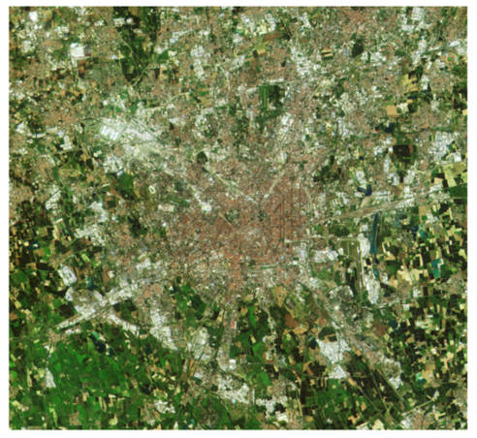
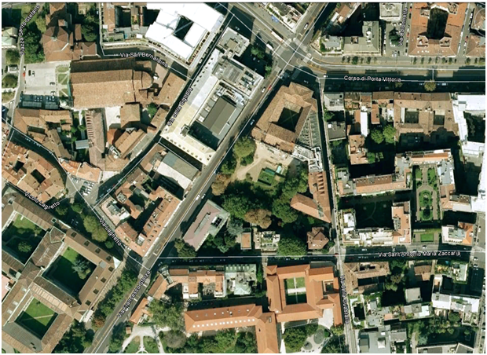

Air Quality in Milan, from problem to solution
In addition to the Sustainable Mobility Action Plan (SUMP):
traffic emissions reduction (LTZ and more)
electric revolution
retrofitting of old vehicles
measures for the reduction of atmospheric particulate matter, by intervening on public transport
construction machinery emissions improvement
Milan Air Quality Plan
The Po valley one of the most developed, densely populated, industrialized, yet polluted areas in Italy and Europe and Milan is at its very core. Two infringement cases:
Infringement procedure 2015/2043 due the pollution level of NO₂
Infringement procedure 2014/2147 due the pollution level of PM₁₀
PM₁₀
In 2017 daily average limit value of 50 µg/m³ exceeded 97 days/year (35 days admitted by EU)
NO₂
In 2017 annual average of 50 µg/m³ (over the annual limit value of 40 µg/m³)
In addition to the Sustainable Energy Action Plan (SEAP):
energy efficiency in buildings
Incentives for a different energy mix in residential heating
The Plan for Air Quality improvement in Milan (draft)
Systematization and centralized approach for all actions and measures that concur to reach compliance with the EU limit values of pollutants
strategic commitment of public authorities
From ‘urban’ scale to ‘proximity’ approach
Coordination with Metropolitan area
Integration with PRIA (Regional Air Quality Plan)
schools and sensitive groups protection
urban forestation
public and private green
Short term: achievement of results
Long term: maintenance of the results

Slide 4





Generalising the case
Territory morphological characteristics
Impact on pollution
In areas like the Po Valley (where Milan is located) critical morphological characteristic are:
poor ventilation
frequent thermal inversion conditions with pollutants stagnation
The specific case of Milan requires that a joint action is coordinated with surrounding municipalities and all Regions of the Po Valley
Example: Po Valley Agreement between the Italian Ministry of Transport and Infrastructure and Lombardia, Piemonte, Veneto e Emilia-Romagna
Impact of ship emissions on pollution on cities having important commercial ports
Ports represent a significant source of pollution. Specific measures ought to be considered to incentivise green behaviour
Examples: Amsterdam, Le Havre, Rotterdam, Gioia Tauro, Taranto
Macroeconomic context
Financial support
GNI per inhabitant less than 90% of the EU average (cohesion fund regions)
€63,4 billion from the EU Cohesion Fund to projects related to energy efficiency, developing rail transport, strengthening public transport ecc.
Cohesion countries: BG, HR, CY, CZ, EE, GR, HU, LV, LT, MT, PL, P, RO, SK, SI
GDP per capita is < 75% of EU average (Less developed regions)
ESIF funds allocation in less developed regions exceed the EU financial allocation in more developed regions
Less developed regions in Europe
Developed vs. developing, where energy investments are driven by population and economic growth and energy demand growth
Support from funds which leverage public sector funds to catalyse private sector investment
Example: Global Energy Efficiency and Renewable Energy Fund (GEEREF)
4

Slide 5









Sources of finance
Financial needs
€
Financing schemes
5

Slide 6
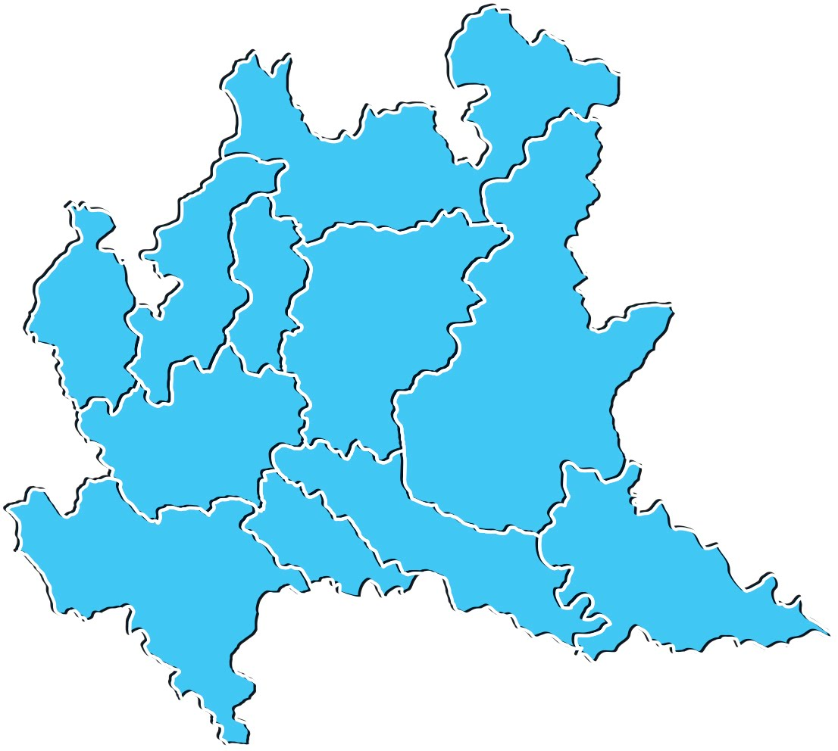

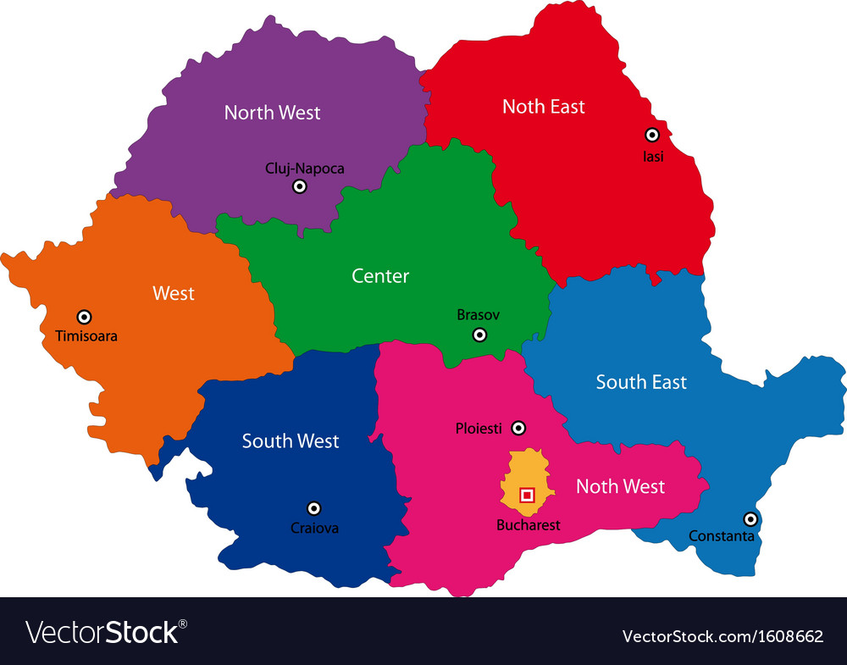
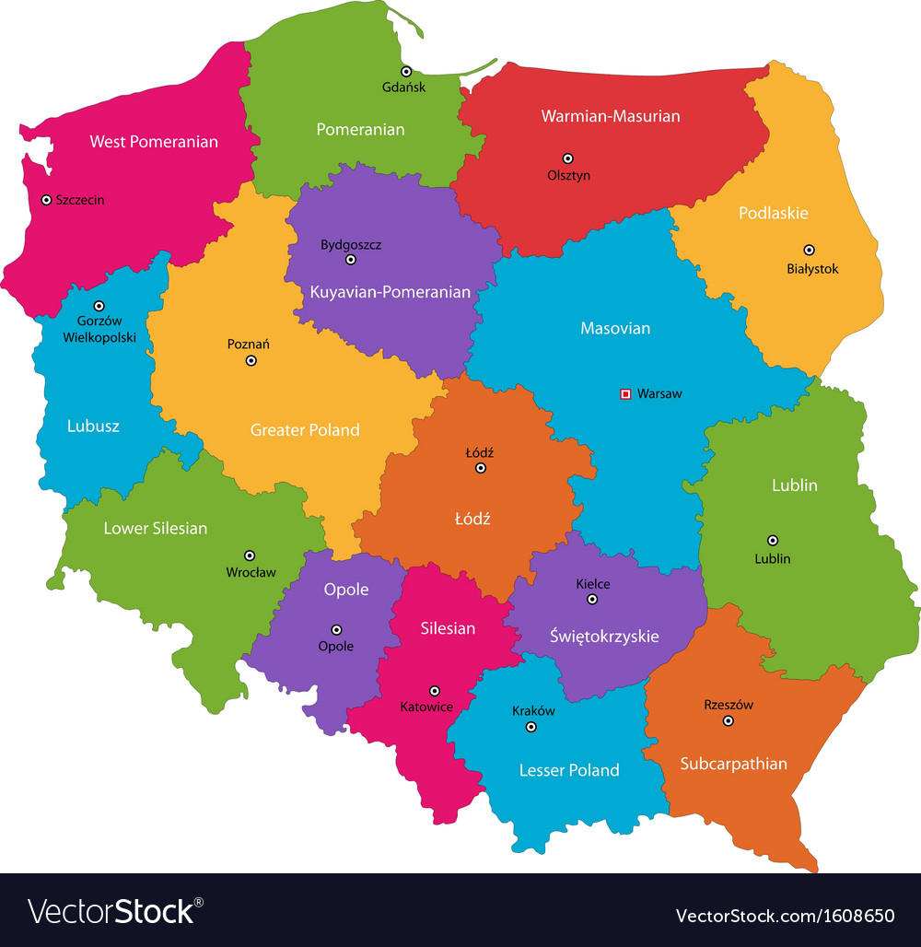
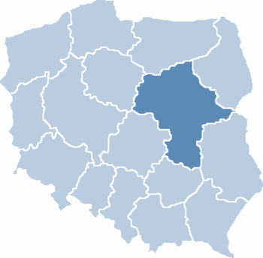
EU support to AQ measures… examples across MSs
Facts & figures
in the Operational Programmes, air quality tends to be considered as an integrated measure with other priority areas
in cohesion countries air quality actions tend to be managed at centralized level (e.g. in Bulgaria, OPs operate at national level and in Croatia, the national Environmental Protection and Energy Fund has co-financed the preparation of 3 out of 6 existing AQP for local authorities)
in Lombardia Region €166,2 Million are currently available* for intervention on air quality in the region from the ERDF fund (64% of the initial allocation)
The overall cost for the implementation of the Air Quality Plan in Milan accounts for few billion EUR
*Data are up-to-date as of 30 June 2018
Lombardy Region (Italy)
Bulgaria
Romania
GDP: € 357 billion
GDP: € 50.4 billion
GDP: € 162 billion
Population: 10 M
Population: 7 M
Population: 19.7 M
ERDF TO IV-VI: 214 M€
ERDF TO IV-VI: 596 M€
ERDF TO IV-VI: 2.3 bn€
Focus Cohesion Fund support
Air quality projects in Bulgaria, Romania and Poland are eligible for the support from the EU Cohesion Fund, that allocate on the TO IV and VI
6.2 bn€ in Bulgaria
17.9 bn€ in Romania
24.2 bn€ in Poland
Poland
Masovian Voivodeship Region (Poland)
GDP: € 466 billion
GDP: € 93 billion
Population: 38 M
Population: 5 M
ERDF TO IV-VI: 4.4 bn€
ERDF TO IV-VI: 501 M€
6

Slide 7



Schemes to support Air Quality Plans
Overview of schemes to finance air quality plans
Financially sustainable measures
Non-financially sustainable measures
Savings/ revenues can be leveraged to repay initial investments
Benefits not monetized in the market
Public resources
The public initiative
Investment attractiveness
Private companies may be interested
The public administration shall cover capital expenditures and and operational ones
Loans can be repaid with the financial inflows generated by the investment
The loan conditions
Loans can be only repaid with public resources
Private resources
Potential return on investment
When cost of capital is lower than debt, long-term conditions are favorable and/or when no sufficient public resources are available in upfront
Other forms of private involvement can be envisaged
7

Slide 8
Schemes to support Air Quality Plans in our cities
8

Slide 9
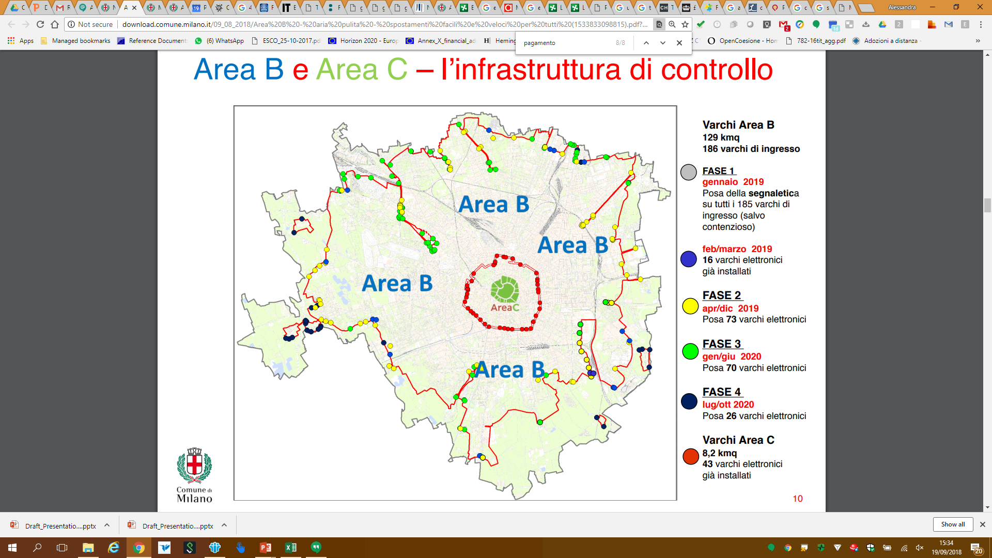



Schemes to support Air Quality Plans
Transport pollution-reduction measures
Milan Low Emission Zone
Opportunities to structure the “LEZ” financially sustainable
Experiences from other cities show how different approaches can be applied to reduce emissions and, at the same time, raise capital for urban investments.
Residents and area
128,29 kmq of area and 1,4M residents
Generalised case of pollution-charge scheme
Road users
charges
Car renewal incentives
Vehicles prohibited
unleaded Euro 0 and diesel Euro 0,
1, 2, 3 and progressively, for subsequent
steps up to 2030, all diesel vehicles
Taxpayers
Transp. authority
surplus
Control modes
Camera systems in 186 entry points
Lenders
Transport investments
EV infra
infra maint.
…
Fines
€ 80
Infra.
O&M
Sustainability
Not revenue generating
Examples: State of Colorado Special Fuel Tax and EV fee; TfL C-charge, T-charge; State of Oregon’s OReGO Program VKT fee
ensures the collection of capital that can be invested in other measures
the scheme may not reach the environmental objectives, as users may prefer to pay the charge rather than changing their vehicles/ behaviour
Ecopass was designed in Milan with this approach. It has then been amended towards a non-economic incentivising measure.
Alternative scheme: possibility of considering intermediate sustainability solutions (i.e. externalities).
Necessary conditions
clear definition of the objective: financial sustainability oriented vs. environmental objective oriented
regulations allowing imposing charges and penalizing non-compliance
low commuter number and car density
zone sufficiently large to avoid pushing traffic in adjacent areas
local public transport sufficiently developed within the restricted areas and in connection with the surrounding areas
9

Slide 10
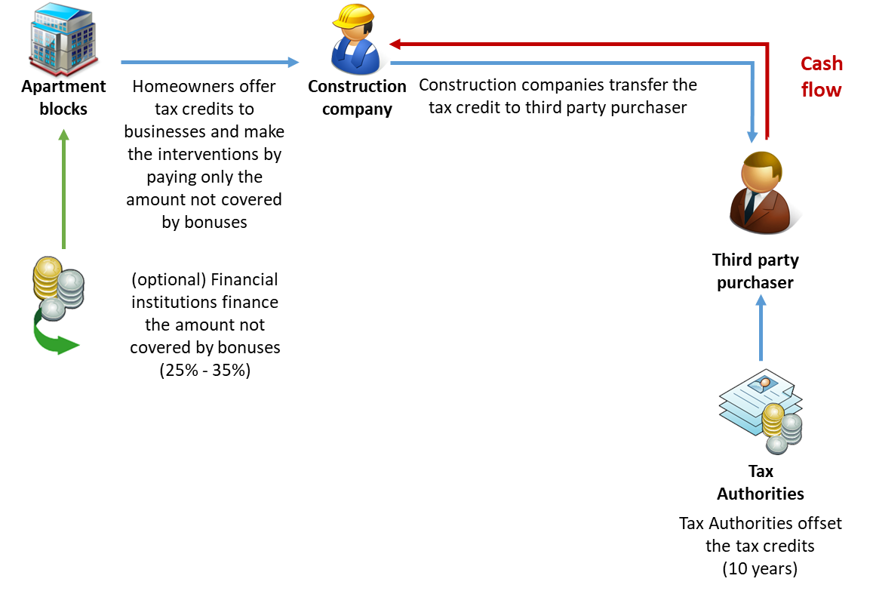
Schemes to support Air Quality Plans
Energy-related measures
Residential buildings
The steps towards sustainable residential buildings mainly concerned the implementation from the Municipality of Milan of restrictions and incentives through Municipality’s own resources.
Project level scheme - the Harley & Dikkinson platform
A real-case example is represented by the H-D platform, which is based on transferring the tax-credit from homeowners and condos to repay for the energy efficiency and residential energy mix investments.
Bando BE2 - Municipality of Milan
Substitution of diesel generator (60% of resources) and works on the building plant systems (40% of resources)
Financial Instruments
grant (up to 20%) + soft loans (10 year tenor, 4% interest rate)
Beneficiaries
homeowners, private companies, public entities
Financial intermediaries
BCC Milano, Credito Valtellinese, Banco BPM, UniCredit
Necessary conditions
presence of legislation for the provision of bonus (i.e. tax credit) for EE measures
possibility to transfer bonus to others
bureaucracy barriers: authorisations time
Resources
€ 23.250.000
Sustainability
(partially) financially sustainable: costs savings on fuel expenditure after the intervention + tax credit + grant

Slide 11





Schemes to support Air Quality Plans
Re-greening measures
The case of “Aree Verdi regional fund” in Lombardy
compensation tax to support the development of re-greening project in urban areas and green-infrastructures
GREEN ROOFS - Opportunity to maximize the financial sustainability through impositions by the authorities
River Smart Rooftops Green Roof Rebate Program (Washington DC): incentives through local sources for the installation of green roofs + offset costs for structural assessment
Green Roof Strategy and Green Roof Bylaw (Toronto): incentives + cash-in-lieu from developers who choose not to install a green roof
Toronto specificity: the Program became completely self-sustaining when Council directed that funds collected as cash-in-lieu of construction of a green roof be directed to the Eco-Roof Incentive Program for the provision of both green roofs and cool roofs
New Real Estate developments
City / Local Authority
Re-greening projects
construction fee from 1.5 to 5%
P1
P2
P3
P..
Sustainability
Financially sustainable
Profit
Social benefit
“Cura e adotta il verde pubblico” Initiative City of Milan
commercial visibility to private entities supporting the enhancement of public green areas
Profit
Private Sponsor
Necessary condition
to maximize its impact the measure should be implemented throughout a whole town
real estate market shall be strong and very profitable
imposition by the authorities should be in force (e.g. duties provided by the building regulations)
Green care interventions
Commercial visibility
Public green
Sustainability
Financially sustainable
11

Slide 12
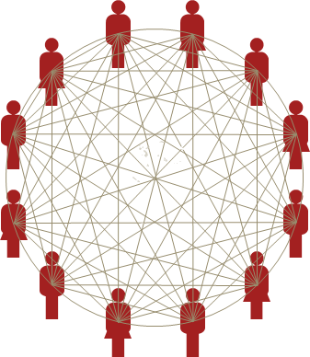
Schemes to support Air Quality Plans
(inter-) Municipal Fund
Development of a Fund (Air Quality Fund), involving municipalities, institutional investors, private investors and public sources (EU, national, regional), that share the goal of air quality improvement in the area.
A model of (inter-) Municipal Fund
Opportunity: a dedicated Fund
Municip. 1
Municip. 2
Municip. n
Institutional investors
“Air Quality” Fund
Leadership of the operations
municipalities
Other public resources
Geographical extension
metropolitan area level?
Private Investors
Sectors
heterogeneous (e.g. residential and public buildings, transport, degraded areas redevelopment, etc.)
Financial products
flexible: equity, loans, guarantee, mezzanine, etc.
Geographical extension of the projects
Sector A
Sector B
Project 1
Project 2
Project ...
Project 1
Project 2
Project ...
Necessary conditions
interest from speculative and non-speculative investors
identification of the geographical extension of the project
need of homogeneity among municipalities from an urban point of view
heterogeneity of projects (size, ownership, purpose) to attract financial investors interested in diversifying their portfolio in order to reduce risks
12

Slide 13

Sources of Finance
EIB Framework Loan
Framework loan
multiple small and medium sized projects, usually in the size range EUR 1-50 million
the EIB framework loan providing up to 50% of the total financing
EIB+EU financing cannot together exceed 90% of the total investment programme in transition and less developed regions (70%)
Typical project cycle for EIB Loan Framework contract
EIB reviews investment plan
questionnaire to the city
1-2 appraisal visit by EIB team
Discussion by the parts
Identification of a project opportunity
Project appraisal:
Fin. Ec. Soc. / Env. Tech.
Review
Board Director
Conditions
In EIB experience
cities w. population >75.000
generate sufficient investment volume to justify a framework loan
Experience in numbers
Between 2005 and 2015
some 70 framework loans were signed with 47 EU cities
totaling over EUR 7.5 billion of EIB infrastructure investment
Loan approved
Repayment
Monitoring
Disbursement
Sign
Negotiation
grace period during construction 3-5 years
tranches with no fees/ penalties
on-budget count as municipal debt
City send reports to EIB
Periodic EIB visits
City send information on specific projects
EIB confirm eligibility
Features on the single project eligibility
Projects < EUR 25m are selected by the borrower in line with EIB eligibility req.
Projects between EUR 25-50m need to be approved by the EIB
Projects above EUR 50m need a full separate stand-alone appraisal
loan terms: 20-25 years matching economic life of infrastructure
not counted as “state aid“
Up-front disbursement up to 30% of the loan amount
13

Slide 14
Annex: Backup slides
14

Slide 15
Financing Opportunities Overview (1/2)
# | Countries | Managing | Focus areas | Type of measures | Financial Support
European Regional Development Fund (ERDF) | EU- 28 | National or Regional managing authorities DG REGIO | Sustainable transport Energy: use of renewable sources and EE Low carbon economy Environmental protection | Grants and financial support to local investments programme on infrastructures implementation, incentives schemes | Grants (co-financing) Financial instruments: guarantees, loans, equity Technical assistance support Direct agreement. / Comp. calls
Cohesion Fund (CF) | BG, HR, CY, CZ, EE, EL, HU, LV, LT, MT, PL, PT, RO, SK and SI | National or Regional managing authorities DG REGIO | Sustainable transport Energy: use of renewable sources and EE Low carbon economy Environmental protection Institutional capacity | Direct support for infrastructure projects. Support projects related to energy or transport, as long as they clearly benefit the environment | Grants Financial instruments: guarantees, loans, equity Indirect funding (loans, risk capital and seed funding) Direct agreement.
European Fund for Strategic Investments (EFSI) | EU-28 +AL, IS, IL, FYROM, ME, RS , TR, NO, CH, KS | EIB | Infrastructure development in transport Renewable energy and Energy efficiency Environment and natural resources | Instrument to overcome the current investment gap in strategic infrastructure including digital, transport and energy | EIB support guaranteed by the Commission Direct agreement.
EIB Municipal Framework Loans | EU-28 & other countries (e.g. TR, ME, UA) | EIB | Urban roads and public transport Renewable energy and Energy efficiency Environment and natural resources | Loan for a programme of investments (3-5 years), not completely prepared at the time of signing | Local/regional authorities > 75,000 Inhabitants < €50 million Framework agreement with EIB
EEEF | EU- 28 | EC / EIB Cassa Depositi Prestiti Deutsche Bank | Energy Efficiency Renewable energy Clean Urban transport | Investments in the public sector towards energy efficiency and small scale renewable energy projects | Between €5-25 million (smaller project size is possible, reviewed case by case) Direct agreement.
Natural Capital Financing Facility (NCFF) | EU- 28 | EIB DG CLIMA | Land use Environment and natural resources Climate change adaptation | Support projects working on: Payments for Ecosystem Services, Green Infrastructure, adaptation investments | €5-15 million and max €1 million for technical assistance/capacity building Direct agreement. / Comp. calls
PF4EE instrument | Currently operational only in ES, CZ, and FR | EIB DG CLIMA | Public/private building stocks Urban transport Energy efficiency | PF4EE supports local financial intermediaries via low-cost long term loans, credit risk protection and enhanced lending expertise for EE | In the PF4EE between local bank and e.g. local authority: <€5 million Direct agreement.
Horizon 2020 | EU-28 and its Overseas Countries Territories | EC INEA / EASME | Secure, Clean and Efficient Energy Smart Green and Integrated Transport | Support investment in research, testing, pilot projects | Research, Innovation actions: 100-70% co-financing Coordination Support actions: 100% co-financing Competitive calls
LIFE | EU-28 | EASME / EIB DG ENV, DG CLIMA | Climate Change Adaptation / Mitigation Environment & Resource Efficiency | Grants to support implementation of AQAP: implementation of plans, programmes or strategies | Integrated projects: 6 years or more EU contribution: €8 million - €15 million; Competitive calls
15

Slide 16
Financing Opportunities Overview (2/2)
# | Countries | Managing | Focus areas | Type of measures | Financial Support
CEF - Connecting Europe Facility | EU- 28 | EC / INEA | Transport, energy and digital infrastructures | Key EU funding instrument developed specifically to direct investment into European transport, energy and digital infrastructures | Grants / Programme Support Actions / innovative financial instruments Competitive calls
European Investment Advisory Hub | EU- 28 | EIB DG REGIO | Integrated urban investment programmes, with a short to medium term time-horizon, typically 3-5 years | Addressing both city wide investment planning and financing needs for projects as well as integrated urban development programmes | Advisory support to urban authorities: tailor made advice / support innovative financing. Investment target of at least EUR 20M Direct agreement.
UIA - Urban Innovative Actions | EU- 28 | DG REGIO | Urban mobility Energy transition Air quality | Innovative actions to interconnected and interrelated local challenges’: testing new urban solutions in pilot projects | Grant with a maximum of €5 million per project. Co-financing 80% Competitive calls
EBRD - Green Economy Transition (GET) | EBRD countries | EBRD | Climate change mitigation | direct sustainable financing to large corporate clients as well as to municipalities in sectors such as agribusiness, industry, power and energy utilities, and transport | guaranteed loans, direct equity, equity funds and credit lines in the context of individual green project
EEA | 15 EU in Central and Southern Europe and the Baltics | 3 donor countries: Iceland, Liechtenstein and Norway | Environmental protection and management Climate change and renewable energy | Each beneficiary country, in agreement with the donor countries, has chosen a set of programmes that provide grants to projects | Grants Competitive calls
World Bank | Global | World Bank Group | Climate change Transport Buildings | Identify, develop, and mobilize financing for investment programs in urban | e.g. City Resilience Program / City energy efficiency transformation initiative / Global Platform for Sustainable Cities / Climate Auctions Program / Direct agreement.
CEF - Debt instruments | trans-European networks | EC / EIB | Transport (TEN-T), energy (TEN-E) and information and communication technology | alternative to traditional grant funding by offering competitive financial products for priority investments | Loan or contingent credit Direct agreement.
Marguerite Fund II | EU- 28 + pre-accession countries | Independent management board | (i) transport, (ii) energy (iii) mature renewable and (iv) information and communications technology infrastructure | Greenfield: new projects and facilities, with typical development risks largely mitigated (minimum of 65% of the Fund) Brownfield: replacement, modernisation and capacity enhancement of existing assets (maximum of 35% of the Fund) | equity fund Direct agreement.
Fondazione Cariplo | Italy, Lombardia | Fondazione Cariplo | Circular economy, natural capitale, agriculture, energy requalification of buildings and lighting systems | Grants to non-profit organizations | Grant Competitive calls
16

Slide 17


The development of Air Quality Action Plan
Initiatives to setting-up an AQP
Cases of Integrated projects on AQP
1st : Deploy an advanced system to monitoring pollutant sources
PREPAIR - Po Regions Engaged to Policies of Air
Obligations by the adoption of Directive 2008/50/EC
How to:
National/Regional funds to support investments in IoT monitoring systems
EU competitive funds to pilot/testing innovative solutions to monitoring pollutants
i.e. ERDF Lombardy: Action IV CO₂ reduction by implementing intelligent traffic control systems
help the full implementation of AQPs and of measures of the Po Valley Agreement on a larger territorial scale
establish a permanent data sharing infrastructure for monitoring air quality and measures implementation
budget: 16.805.939 € / EU co-financing: 9.974.624 €
beneficiary coordinator: Region Emilia-Romagna and 17 Associated Beneficiaries
i.e. H2020: Upgrading transport infrastructure in order to monitor noise and emissions
2nd : Implement tailored analysis and strategic planning to AQP definition
Małopolska in a healthy atmosphere - Implementation of Air Quality Plan for Małopolska Region
Financial support by the Integrated Project calls in LIFE Programme
Integrated Projects
aiming at implementation of plans required by EU climate legislation
coordination with other EU Funds - Common Strategic Framework
stakeholder involvement compulsory
Air IPs should aim at
implementation of air quality plans developed pursuant to the Ambient Air Quality Directive
or
national air pollution control programmes pursuant to the National Emission Ceilings Directive
response to the needs of governments and the barriers identified during the implementation of the MAQP
accelerating the implementation of the air quality measures set out in the MAQP
facilitate use of financial resources and legal instruments to achieve a real air quality improvement
budget: 16.771.099 € / EU co-financing: 9.914.871 €
beneficiary coordinator: Małopolska Region and 30 Associated Beneficiaries
17

Slide 18

Programme level Funds
The RICE experience
Steps to structure the city fund
Case study for the city of Milan focuses on the potential set-up of a city fund
Maximize the funding available at city fund level
Investors
public funds play key role in the junior tranche of investment
the senior tranche by European public investors
ESIF is managed at regional level (region of Lombardy acting as the MA)
high-level assessment of focus areas
define the structure of the city fund
City’s resources should be leveraged with public and private sources of financing
Areas
Structure
multi-thematic city fund approach
Municipality
Financial Inst.
Other Public Investors
Private Investors
Urban development
Two area of intervention for this case study
Energy efficiency
City Fund
Energy Efficiency
Urban Development
facilitate access to loan financing
Financial needs
repayment of energy efficiency investments
Sub-funds
lower investment risk
Financial Intermediaries
debt to mkt operators
Potential financing options
each homeowner/individual loans
homeowner association/collective loan
reduce borrowing cost
third-party financing entity/ESCO
Projects
P1
P2
P3
P4
P5
….
concessional loan instrument
Types of financial products
collective loans
guarantee
tax credit (credit assignment)
18

Slide 19





Case study: Green bonds
International experience Green revenue U.S. muni bond from Arizona State University
Arizona State University issued $182.6 million of Green Revenue Bonds in April 2015. The bonds had tenor ranging from 1 to 21 years, with corresponding coupons between 2 and 5 percent and AA rating.
The issuance was backed by the University’s revenues, including student tuition and fees and facilities revenues, instead of the full balance sheet of the University.
Proceeds from the Green Bond will be used to refinance LEED Gold certified buildings for the University, although the issuer did not obtain a second opinion on the bond’s green credentials.
Project Pipeline
Financing
Issuer
States, municipalities, enterprises banks and development banks
Repayment
Type of bonds
General Obligation Bond, earmarked for green projects, require full recourse to the issuer, therefore, same credit rating applies as to the issuer’s other bonds
Revenue Bond, earmarked for green projects, revenue streams from the issuer, such as taxes or user fees, provide repayment for the bond
Project Bond, ring-fenced for the specific underlying green project(s), the recourse is only to the project’s assets and revenue
Securitized Bond, either earmarked for green project or go directly into the underlying green Projects, recourse is to a group of financial assets that have been grouped together as collateral.
Bonds
Capital
Repayment
Investor
Capital investment companies, banks and enterprises, government, private investors
19

