Slide 1



Partnership
Air Quality
Code of Good Practice
for Cities Air Quality Plans
Action Leader: City of Milan
Silvia Moroni
AMAT - City of Milan

Slide 2

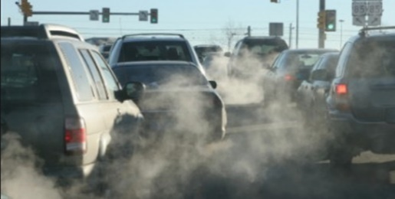

Cities, where more than 70% of Europeans live, are hotspots for air pollution!
Better Air Quality Planning (Governance)
The problem:
Health
Source: Lutz, ‘Air Quality Strategy: measures and expected effects’
Notes:
The work of the Partnership has allowed identifying issues of concern for many cities relating to the development and implementation of Cities Air Quality Action Plans. Notably, it has been found:
That access to knowledge and experiences (e.g. on process optimization, pitfalls, stakeholder interactions, governance, monitoring, etc.) from front-runners cities having already designed and implemented AQAPs is often crucial to avoid inefficiencies, and that such knowledge should be improved.
2. Knowledge of best practices in the selection, design, funding, and implementation of air quality measures is essential to facilitate the choice of the relatively most effective measures for the AQAPs, and that such knowledge should be improved.

Slide 3



Air quality plans benefits:
Better Air Quality Planning (Governance)
Solution:
Air Quality Plan
w
Compliance with
EU legislation
(Dir. 2008/50/EC)*
Realize the ‘Healthy city’
Achievement of Sustainable Development Goals
* also NAPCP (National Air Pollution Control Plan - Dir. 2016/2284/EU)
Notes:
The work of the Partnership has allowed identifying issues of concern for many cities relating to the development and implementation of Cities Air Quality Action Plans. Notably, it has been found:
That access to knowledge and experiences (e.g. on process optimization, pitfalls, stakeholder interactions, governance, monitoring, etc.) from front-runners cities having already designed and implemented AQAPs is often crucial to avoid inefficiencies, and that such knowledge should be improved.
2. Knowledge of best practices in the selection, design, funding, and implementation of air quality measures is essential to facilitate the choice of the relatively most effective measures for the AQAPs, and that such knowledge should be improved.

Slide 4
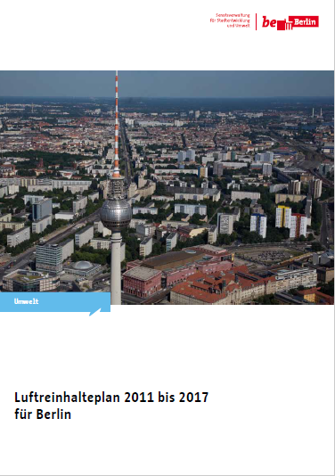
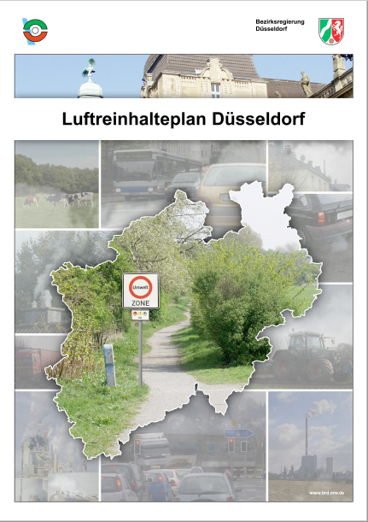
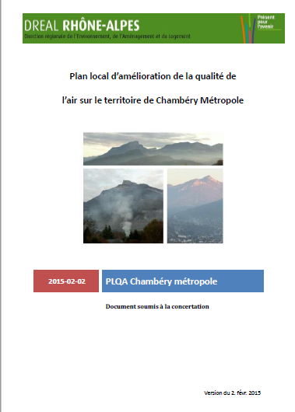

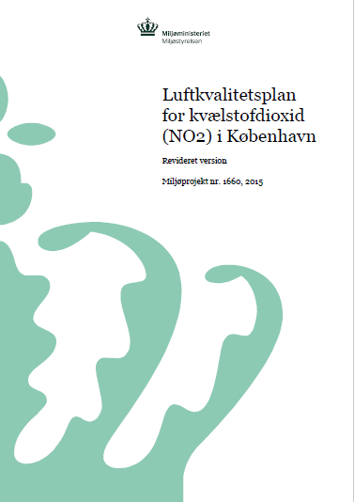
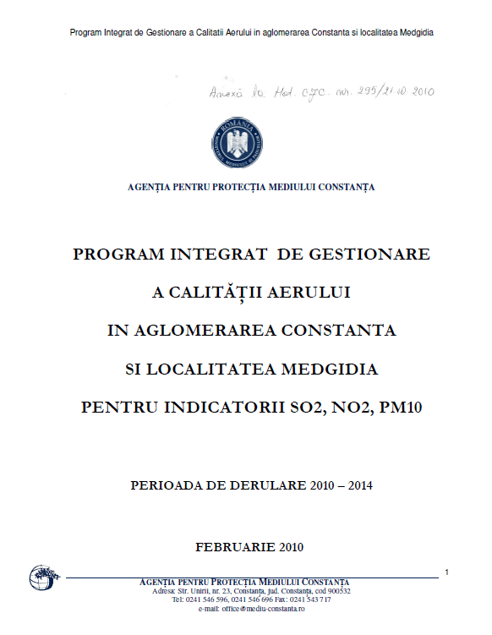
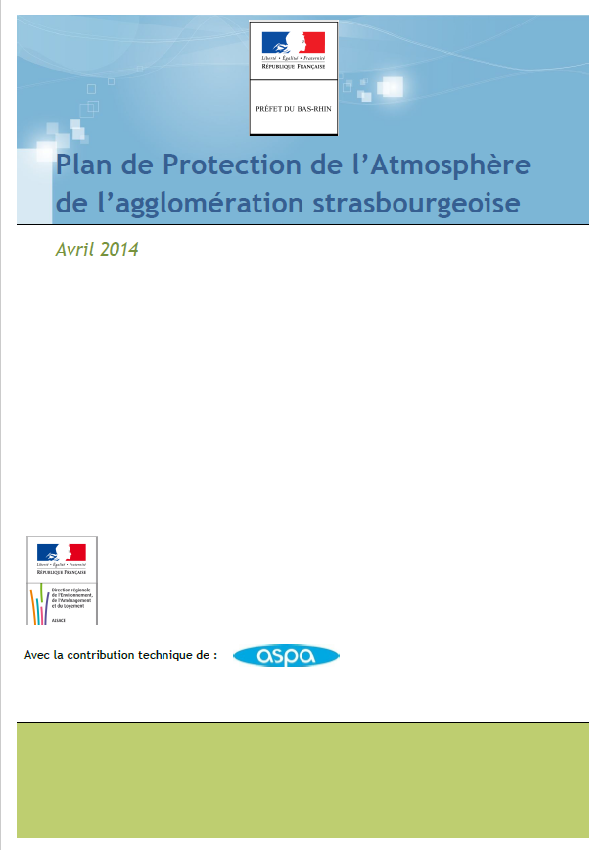
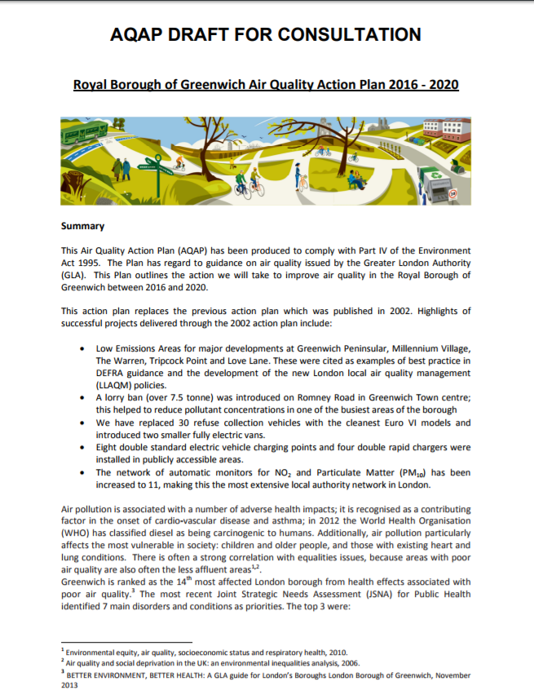
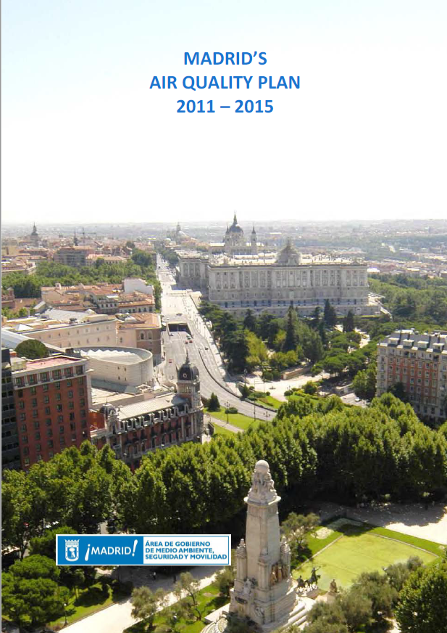
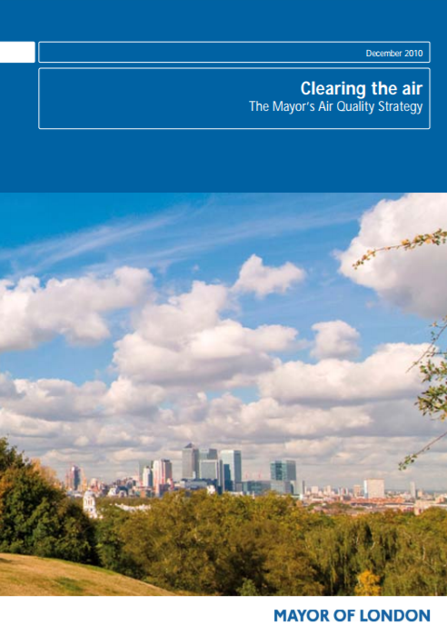
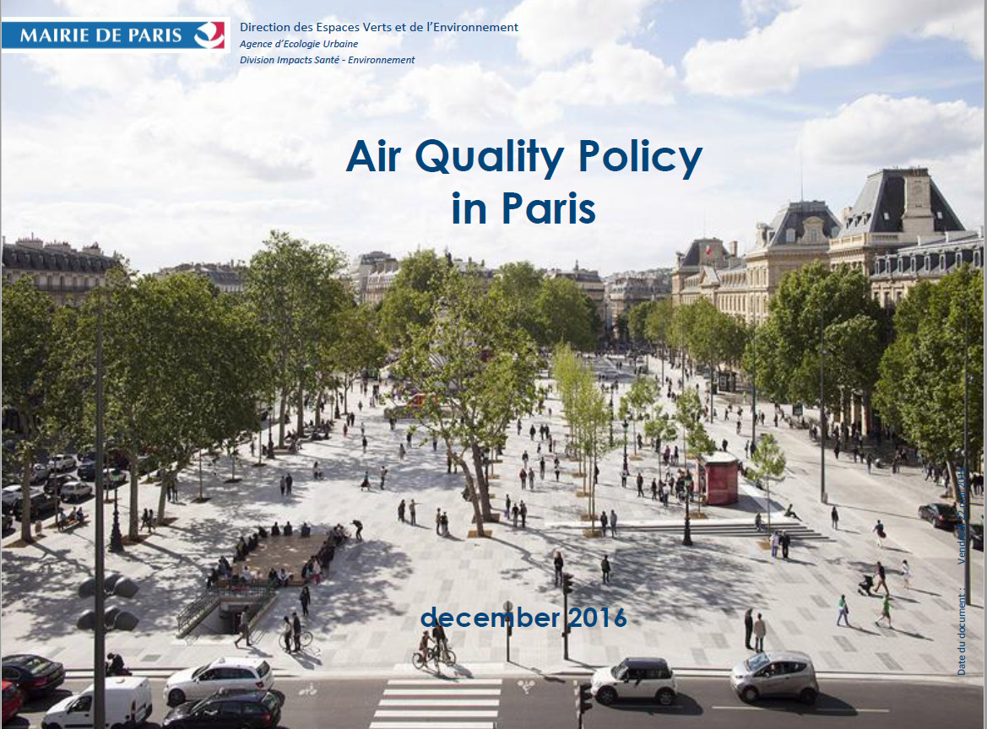

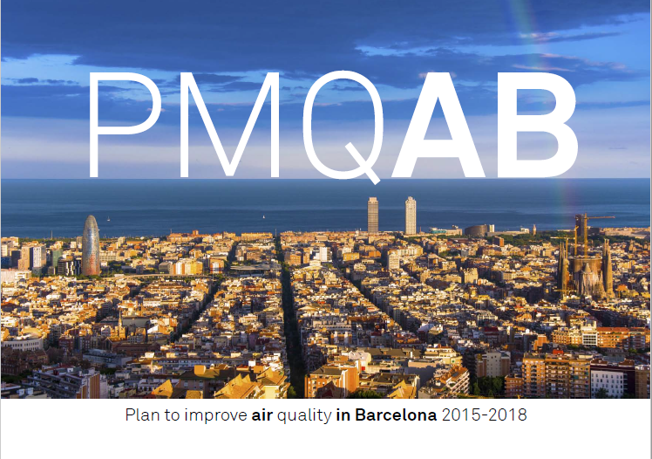
...Partnership finds that a a tool to collect and share good practice from experienced cities is needed…
...but to draft and
implement an
Air Quality Plan
is a difficult task!

Slide 5
Partnership Air Quality work to advice EU cities on APQs:
Analyzed more than 30
Cities Air Quality Plans and
Cities Strategies for Air Quality
Verified law prescription
Interviewed EU AQ experts
Collected best practices in
AQPs and AQ measures

Slide 6

‘Code of Good Practice’ for
Cities
Air Quality Plans
Better Air Quality Planning (Governance)
What
Partnership
developed?
Code
of Good Practice
for Cities
AQPs
(available by end of 2018)
Please, stay tuned!
https://ec.europa.eu/futurium/en/air-quality
Tips on how to better manage and implement Cities AQPs
State of art of methodologies and tools for decision making
Inspiring examples
  Recommendation in AQ planning
A user-friendly guidance
Notes:
The work of the Partnership has allowed identifying issues of concern for many cities relating to the development and implementation of Cities Air Quality Action Plans. Notably, it has been found:
That access to knowledge and experiences (e.g. on process optimization, pitfalls, stakeholder interactions, governance, monitoring, etc.) from front-runners cities having already designed and implemented AQAPs is often crucial to avoid inefficiencies, and that such knowledge should be improved.
2. Knowledge of best practices in the selection, design, funding, and implementation of air quality measures is essential to facilitate the choice of the relatively most effective measures for the AQAPs, and that such knowledge should be improved.

Slide 7
Successful factors for
Air Quality Plans
Better Air Quality Planning (Governance)
Lesson
learnt
Importance of Citizens Awareness raising since the beginning and during the process of the AQP
Firm Commitment and Integrated Planning (other sectors: Mobility, Energy, Climate, Urban Development, ..)
More focus on Health Impact of Air Pollution in AQPs and associated External Cost
Participatory Approach (Stakeholders, main actors, citizens involvement)
Fundamental is Multi-level Governance dialogue; more cooperation between cities, Regions, Member States and EU is needed
Good Business Model for funding implementation
7

Slide 8

Thank you
for your attention!
silvia.moroni@amat-mi.it
PAQ Action 2 Leader
Notes:
8

Slide 9
-
Better targeted funding for air quality
Partnership
Air Quality
ACTION PLAN
Better Funding
Action Leader: City of Milan
Silvia Moroni
AMAT - City of Milan

Slide 10
Challenges
Better Funding
Findings
and Needs
The Partnership observed:
air quality projects funding usually has to compete with other societal challenges => lack of ‘specific programmes dedicated to funding of projects aimed at ‘air pollution reduction’
2. difficult procedures to acquire funding for clean air projects from EU/Member States
3. more possibilities to integrate existing EU/MS/regional
funds for implementing air quality measures
10

Slide 11




‘Business Model’ for Cities Air Quality Plans
(MILAN Pilot Project with EIB)
Better Funding
What is needed?
Guidance for funding
Cities Air Quality Plans
In cooperation with:
Notes:
Improving the targeting of existing funding instruments on air quality, as well as for providing technical assistance for cities to access such funding instruments. As a positive example, the Croatian Environmental Protection and Energy Efficiency Fund (EPEEF) provides co-financing to cities for developing air quality plans and air quality projects, as well as for measures implementation. Likewise, in Poland, the National Fund for Environmental Protection and Water Management funds air quality projects, using resources coming, among other things, from penalties raised on pollutants.
o Having funding bodies play a more active role in making funding opportunities easier to access for cities, as well as in facilitating the dissemination and the uptake of air quality–related project results in EU and national policy making. Promoting better accessibility and dissemination by managing authorities of funding opportunities that are targeted at air quality could help regions and authorities raise awareness on opportunities available and realise the tangible effects of applying for such funds.
How to implement the action?
1. Defining funding needs for the sustainable design/implementation of Cities Air Quality Plans, and assessing sources of funding, and options for their integration. 2. Developing a pilot business model based on the City Air Quality Plans designed based on the Code of Good Practice developed under Action N°2 above. Present results on pilot business model at events and by online dissemination. 3. Drafting recommendations for improving the targeting of existing funding instruments on air quality, as well as their integration, based on the results of the pilot, as well as for having funding bodies make funding opportunities easier to
15
access for cities, and be more active in facilitating the dissemination and the uptake of air quality–related project results in EU and national policy making. 4. Sharing draft recommendations with stakeholders through internet-based public consultation and/or Partnership event and finalization of recommendations.

Slide 12









Better Funding
Sources of finance
Financial needs
€
Financing schemes
or
Business Models

Slide 13


Better Funding
Schemes to support AQPs
Financially sustainable measures
Non-financially sustainable measures
Savings/ revenues can be leveraged to repay initial investments
Benefits not monetized in the market
Public resources
The public initiative
Investment attractiveness
Private companies may be interested
The public administration shall cover capital expenditures and and operational ones
Loans can be repaid with the financial inflows generated by the investment
The loan conditions
Loans can be only repaid with public resources
Private resources
Potential return on investment
When cost of capital is lower than debt, long-term conditions are favorable and/or when no sufficient public resources are available in upfront
Other forms of private involvement can be envisaged

Slide 14



Business Model for Cities Air Quality Plans
Code
of Good Practice
for Cities
AQPs
Code of Good Practice
for Cities Air Quality Plans
Partnership
Air Quality
Air Quality Plans
TOOLS
(available by end of 2018)
Please, stay tuned!
https://ec.europa.eu/futurium/en/air-quality
Guidance for funding
Cities Air Quality Plans
Notes:
Improving the targeting of existing funding instruments on air quality, as well as for providing technical assistance for cities to access such funding instruments. As a positive example, the Croatian Environmental Protection and Energy Efficiency Fund (EPEEF) provides co-financing to cities for developing air quality plans and air quality projects, as well as for measures implementation. Likewise, in Poland, the National Fund for Environmental Protection and Water Management funds air quality projects, using resources coming, among other things, from penalties raised on pollutants.
o Having funding bodies play a more active role in making funding opportunities easier to access for cities, as well as in facilitating the dissemination and the uptake of air quality–related project results in EU and national policy making. Promoting better accessibility and dissemination by managing authorities of funding opportunities that are targeted at air quality could help regions and authorities raise awareness on opportunities available and realise the tangible effects of applying for such funds.
How to implement the action?
1. Defining funding needs for the sustainable design/implementation of Cities Air Quality Plans, and assessing sources of funding, and options for their integration. 2. Developing a pilot business model based on the City Air Quality Plans designed based on the Code of Good Practice developed under Action N°2 above. Present results on pilot business model at events and by online dissemination. 3. Drafting recommendations for improving the targeting of existing funding instruments on air quality, as well as their integration, based on the results of the pilot, as well as for having funding bodies make funding opportunities easier to
15
access for cities, and be more active in facilitating the dissemination and the uptake of air quality–related project results in EU and national policy making. 4. Sharing draft recommendations with stakeholders through internet-based public consultation and/or Partnership event and finalization of recommendations.

Slide 15
Thank you
for your attention!
silvia.moroni@amat-mi.it
PAQ Action 3 Leader
Notes:
15

Slide 16
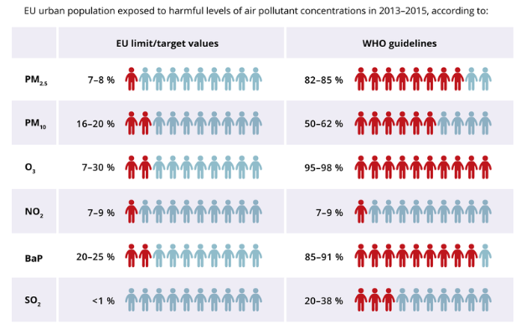
% of the urban population in the EU-28 exposed to air pollutant concentrations above certain EU and WHO reference concentrations, in 2013-2015 period
Better Air Quality Planning (Governance)
The problem:
Health
w
Notes:
The work of the Partnership has allowed identifying issues of concern for many cities relating to the development and implementation of Cities Air Quality Action Plans. Notably, it has been found:
That access to knowledge and experiences (e.g. on process optimization, pitfalls, stakeholder interactions, governance, monitoring, etc.) from front-runners cities having already designed and implemented AQAPs is often crucial to avoid inefficiencies, and that such knowledge should be improved.
2. Knowledge of best practices in the selection, design, funding, and implementation of air quality measures is essential to facilitate the choice of the relatively most effective measures for the AQAPs, and that such knowledge should be improved.

Slide 17
Action 2
-
Better
Air Quality Planning
(Governance)
Action Leader: City of Milan
Partnership
Air Quality
ACTION PLAN
Better Regulation
& Implementation

Slide 18
Partnership
Air Quality
ACTION PLAN
BETTER REGULATION AND IMPLEMENTATION
ACTION 1: Identification of Gaps in Regulation and Implementation on Air Pollutant Emission Sources
ACTION 2 - Better Air Quality Planning (Governance)
2. BETTER FUNDING
ACTION 3 - Better Targeted Funding for Air Quality
3. BETTER KNOWLEDGE
ACTION 4 - BETTER FOCUS ON THE PROTECTION AND ON THE IMPROVEMENT OF CITIZENS’ HEALTH
ACTION 5 - AWARENESS RAISING AND KNOWLEDGE SHARING
ACTION 6 - OUTREACH
MILAN
Action Leader
MILAN
Action Leader
Actions
on
Air Quality Plans

Slide 19
Air Quality Plans
Better Air Quality Planning (Governance)
Legislation
Strategic Planning instruments introduced by the Ambient Air Quality Directive (Dir. 2008/50/EC)
Compulsory Plans for ‘zone’ and ‘agglomeration’ within which the concentrations of pollutants in ambient air ‘exceed any Limit value or Target value’
Mandatory elements listed under Annex XV, Section A of Directive 2008/50/EU
Have to set out appropriate and cost-effective measures to achieve compliance, keeping the period of exceedances ‘as short as possible’
Infringement proceedings against MS if no AQP
Connection of AQP with NAPCP (National Air Pollution Control Plan) (Dir. 2016/2284/EU), mandatory from April 2019
19

Slide 20
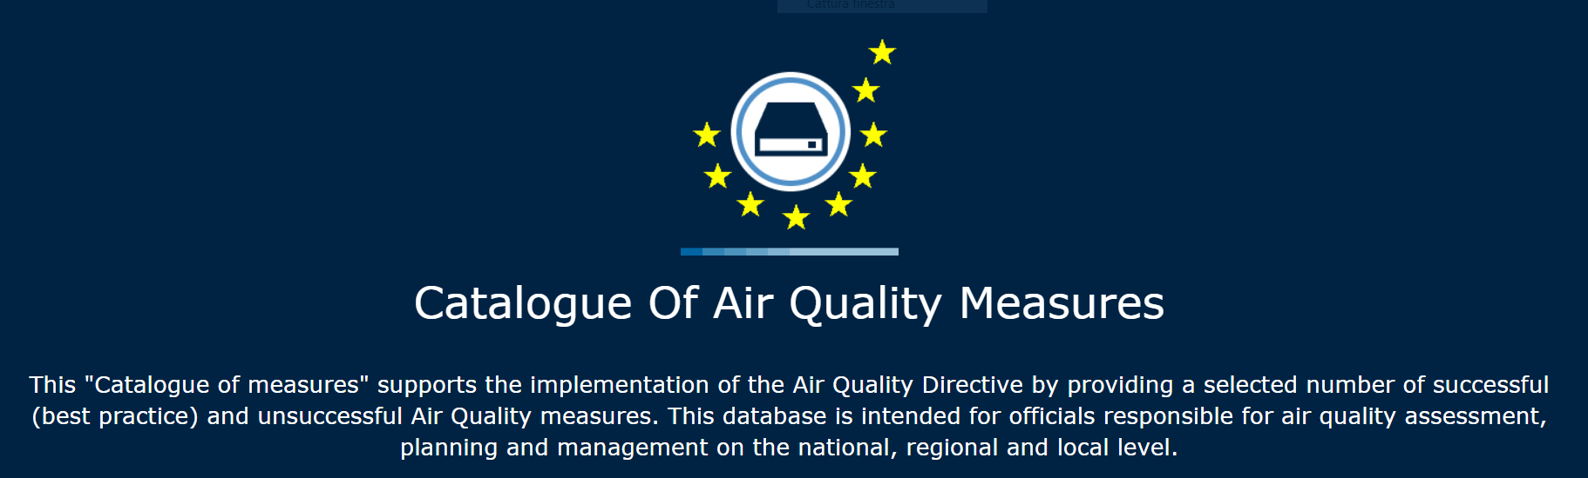
Best Practices in
Air Quality Measures
Register
ACTION 2
Tool n. 1
EC/JRC Register
Collection of Best Practices examples in AQ measures
Keep updated the existing EC/JRC Register:
Your Cities/Authority
Local experience/
Best practice
20
Notes:
2. Knowledge of best practices in the selection, design, funding, and implementation of air quality measures is essential to facilitate the choice of the relatively most effective measures for the AQAPs, and that such knowledge should be improved.

Slide 21
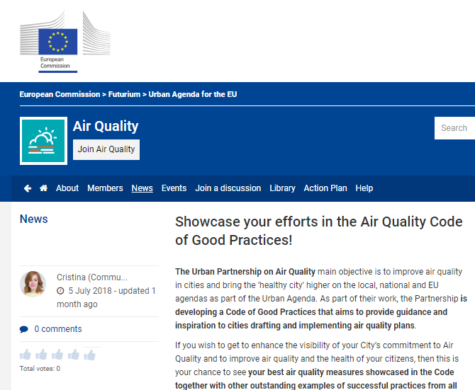
ACTION 2
Tool n. 1
Please, give your contribute < 31 October for updating the JRC Catalogue of Measure for Air Quality
on the EU Website
FUTURIUM
EC/JRC Register
…AQ measure you’ll describe could be insert in the Code
https://ec.europa.eu/futurium/en/air-quality

Slide 22
Air Quality Plans
ACTION 2
Better Air Quality Planning (Governance)
Legislation
Strategic Planning instruments introduced by the Ambient Air Quality Directive (Dir. 2008/50/EC)
Compulsory Plans for ‘zone’ and ‘agglomeration’ within which the concentrations of pollutants in ambient air ‘exceed any Limit value or Target value’
Mandatory elements listed under Annex XV, Section A of Directive 2008/50/EU
Have to set out appropriate and cost-effective measures to achieve compliance, keeping the period of exceedances ‘as short as possible’
Infringement proceedings against MS if no AQP
Connection of AQP with NAPCP (National Air Pollution Control Plan) (Dir. 2016/2284/EU), mandatory from April 2019
22

Slide 23
Lesson Learnt
ACTION 2
Better Air Quality Planning (Governance)
Challenges
Cities remain the immediate level of intervention in dealing with primary pollutants produced by local activities and for health protection of citizens …
…but ‘Air quality planning’ is not always under the responsibility of cities
AQ measures defined in the AQP should address different sectors, whose enforcement and implementation are of competence of urban, regional or national authorities, as appropriate
Integrated planning + Multi-level Governance dialogue and cooperation is needed
23

Slide 24
Challenges 2/2
ACTION 3
Better Funding
Findings
Cities are in demand:
for more possibilities to integrate existing EU/MS/regional funds for implementing air quality measures
for an increase in the relevant funding options for urban projects/plans to carry out air quality management solutions (i.e. Cities Air Quality Plans).
This issue is particularly sensitive for those urban areas where the costs of local abatement measures for Limit Values compliance are remarkable (stronger measures and wider range of action to be taken).
24

