Slide 1
Better Knowledge Action
“Local Cooperation Centres for Innovative and Responsible Public Procurement”
Sanne van Kamp, city of Haarlem
Partnership on Public Procurement

Slide 2
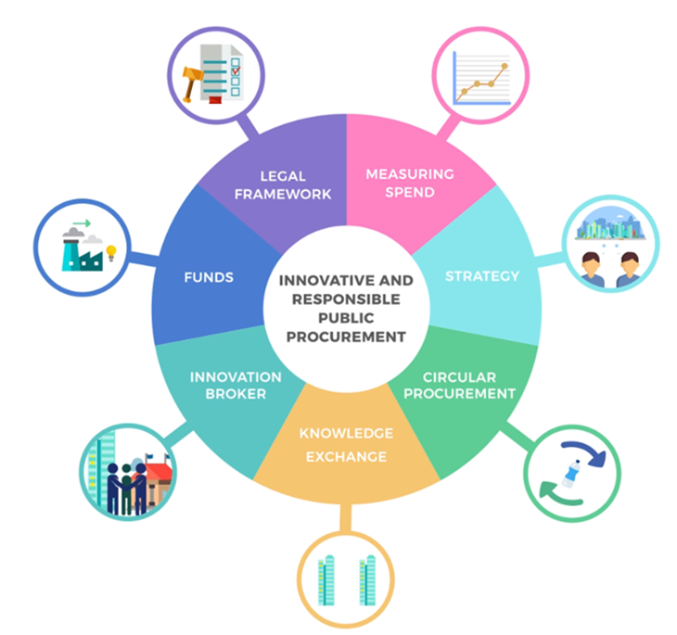
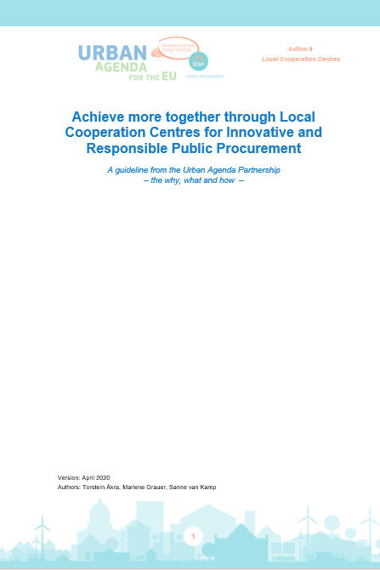
Better Knowledge “Local Cooperation Centres”
Steps
Orientation paper
Action plan
Implementing plan
  Map existing initiatives and
  collect good practices
  Compile a list of possible testcases
  Set up and carry out a questionnaire
  Study visits
  Analyse data
  Draw up a guideline
  Testing & perfecting
  Final document
  Dissemination
  E-learning tool
  Formal launch in October 2020

Slide 3

A structured approach
Action plan was the fundament of implementation
  Focus on the process
Contact
  4 live meetings per year to discuss progress
  In between conference calls
  Study visits
    Working arrangements
  Agree in unison
  Shared workload

Slide 4
The good and the we-could-have-done-it-better
Process
  Clear and precise action plan: existing initiatives, questionnaire, good practices, study visits
  Professionals in action group, gap was filled by expert
  We should have started with Why How What (https://www.youtube.com/watch?v=4KV_BDIhRJY)
Flexibility was needed
  Life intervened sometimes (work, family, illness)
  Involve and present new partners
Live meetings were more effective than online or by phone
Communication: respect was key
  Differences in preferred communication & expression
  Confidence in each other’s expertise, competences and commitment
  Sometimes we had to agree to disagree

Slide 5

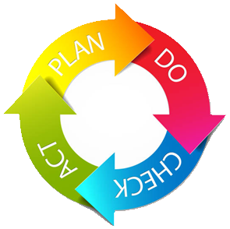
In conclusion
Keep in mind why you are working together (Partnership and Action)
Know your people, respect them and use them
Take your time: be flexible, yet firm
Embrace cultural & personal differences
Invest in good atmosphere
Plan, do, check, act
for continuous improvement

Slide 6
Thank You!

