Slide 1
Better Funding Action
“The Circular City Funding Guide”
Jonas Byström, European Investment Bank
Partnership on Circular Economy

Slide 2
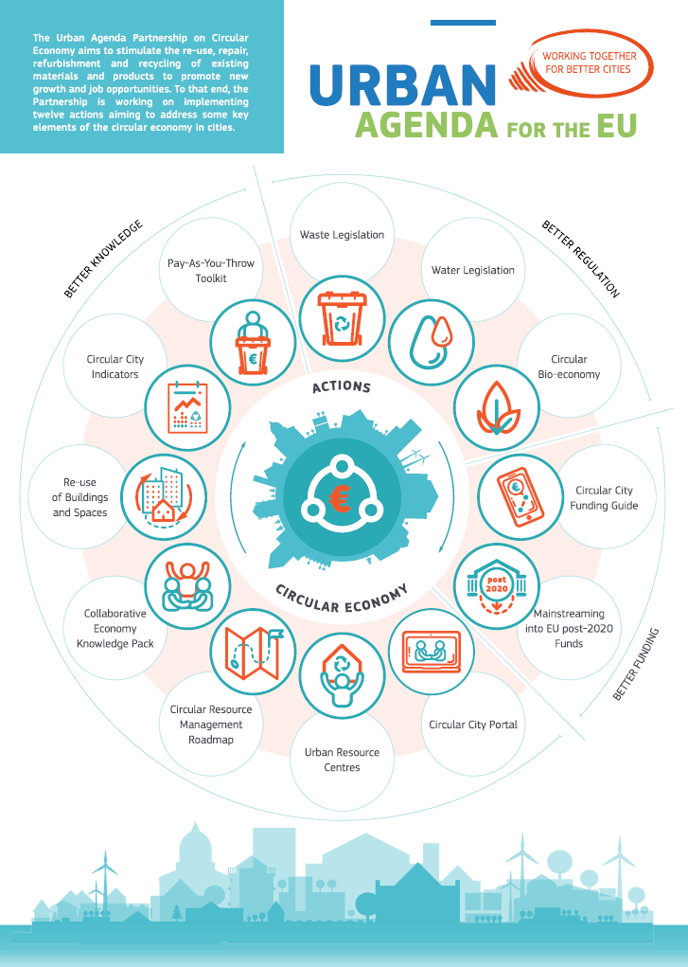
The Action Plan
12 Actions to promote
circular economy in cities:
- 3 on Better Regulation
- 2 on Better Funding
- 7 on Better Knowledge

Slide 3
Drivers for the Actions
CE projects/promoters in cities are in most need of financing and advisory support
Accessing finance is a major challenge for CE projects/promoters
Guidance is needed for both fund-seekers and funders
There is a need to bridge the gap between fund-seekers and funders
A lot of CE financing information is publically available, but usually focuses
on one aspect/topic, and do not consider the urban context
The Guide willl complement other initiatives on circular cities
(e.g. EMF, OECD, Climate-KIC)
Need to interface with e.g. the CE stakeholder platform, the CE Finance Platform

Slide 4
Implementation of the Guide
Stakeholder consultation
UAP CE Working group
CE/funding stakeholders
Key cities
4 WG meetings
Consultant support
Financing under the Advisory Hub
Consortium of PNO consultants and INNEN
1 year development + 1 year follow up
Interviews with 20 cities, 10 funding institutions
User analysis and journey maps
Potential website hosts considered
CE stakeholder platform
EUKN
SCREEN project
EIAH/EIB

Slide 5

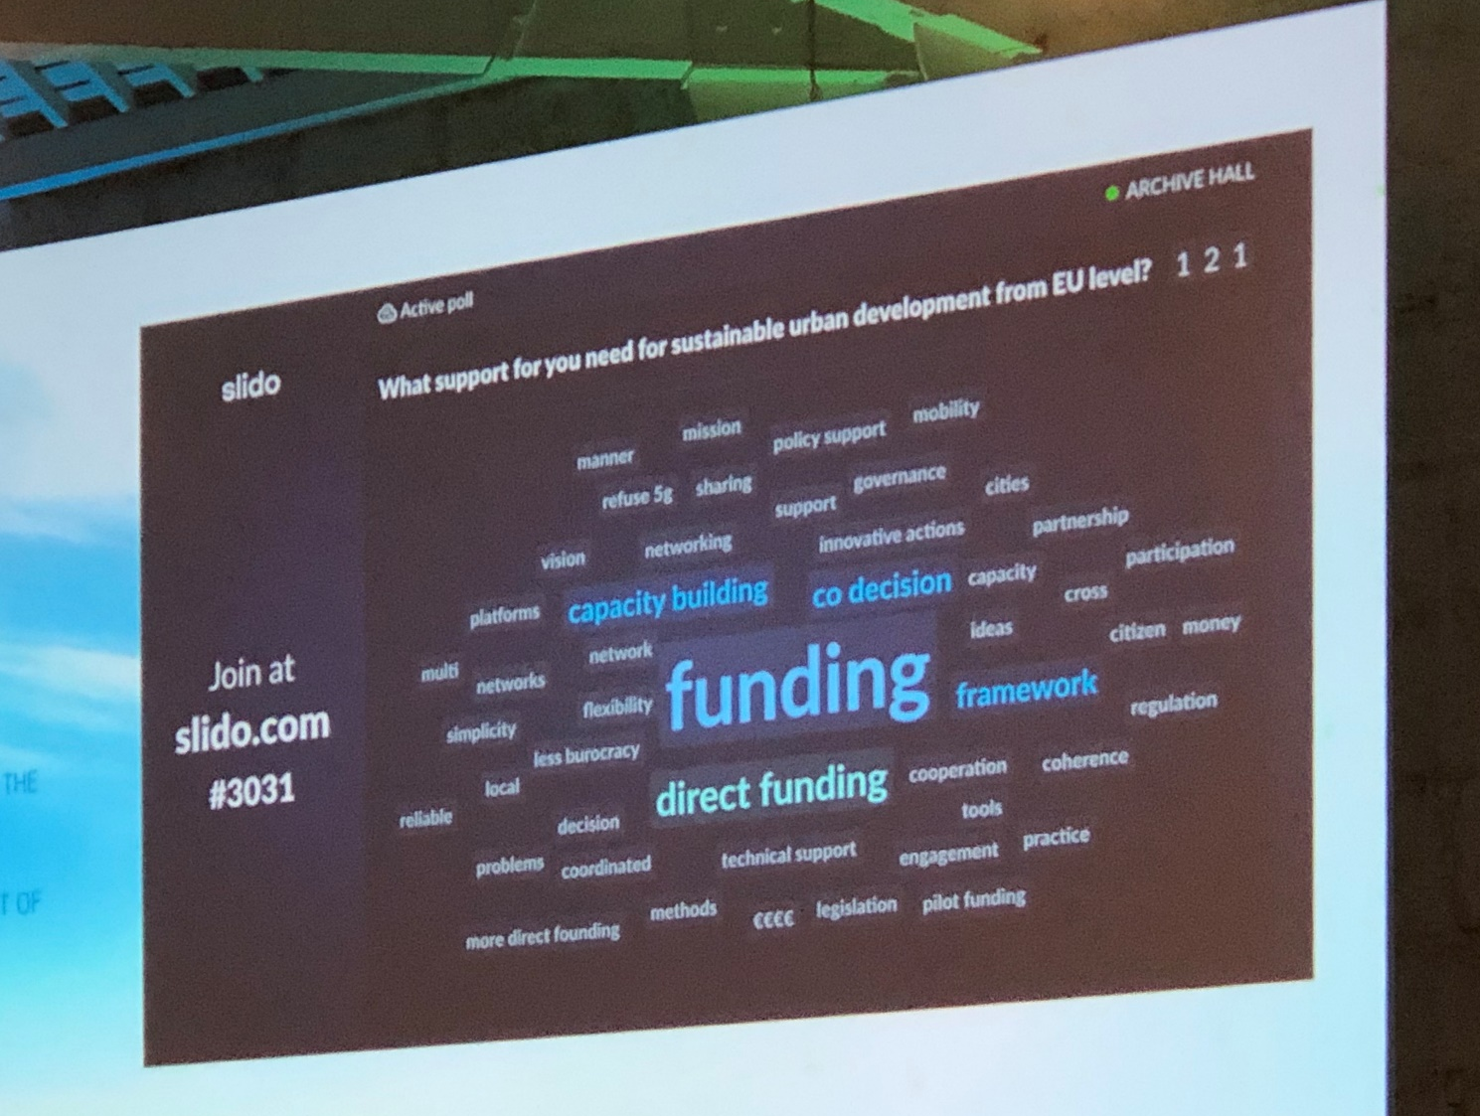
Launch of the Guide
Funding was in the focus

Slide 6
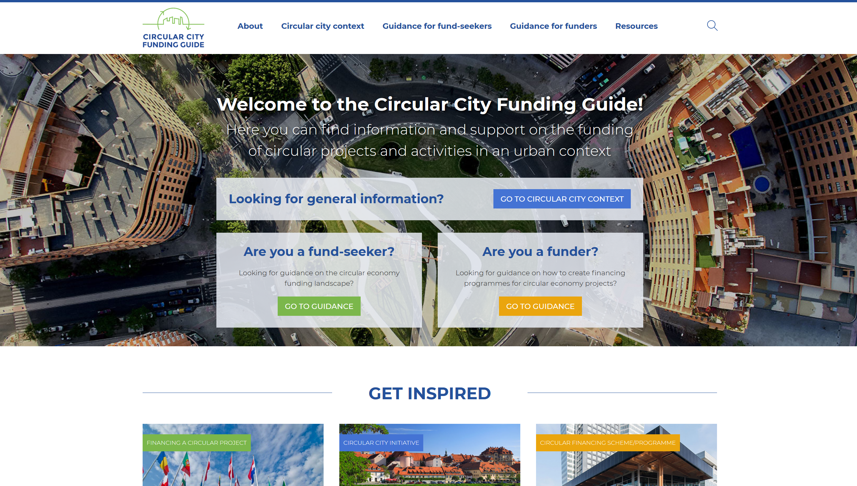
www.circularcityfundingguide.eu

Slide 7
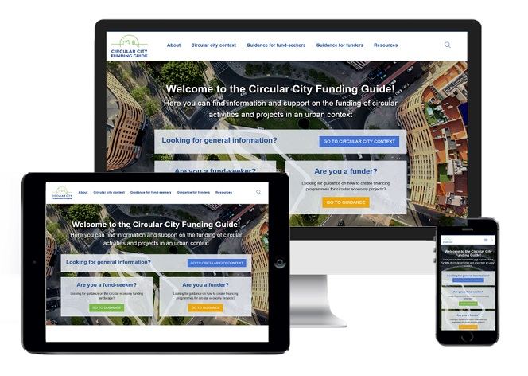



www.circularcityfundingguide.eu
Join #CircularCityFundingGuide group
bystroem@eib.org

Slide 8
Thank You!

