Slide 1
European Urban Initiative
Pia Laurila | DG REGIO – European Commission
Coordinators’ & Action Leaders’ Meeting

Slide 2
European Urban Initiative (EUI) of the post-2020 Cohesion Policy
Strands/activity areas
Objectives
  Strengthen integrated and participatory approach to sustainable urban development
  Provide a stronger link to EU policies, in particular to Cohesion Policy
  Addressing fragmentation of support offered to cities under Cohesion Policy
Beneficiaries
  All EU urban areas; shall support Urban Agenda for the EU; upon request, support for inter-governmental cooperation on urban matters
Support of innovative actions
Support of capacity and knowledge building, policy development and communication

Slide 3




Cohesion Policy support to cities in 2021-2027 and the ambition of EUI
Investments in sustainable urban development
  Minimum 6% of ERDF to sustainable urban development at Member State
  level (‘Article 9 cities’)
  Policy Objective (5) Europe closer to citizens
European Urban Initiative
  More coherent support to cities to overcome current fragmented landscape of various initiatives, programmes & instruments in support of cities under Cohesion Policy
  Support of the Urban Agenda for the EU and intergovernmental cooperation on urban matters
Urban support tools of Cohesion Policy part of EUI in post-2020 period:
URBACT IV
complementing*
Intergovernmental cooperation
on urban matters
DGUM
UDG
*URBACT IV under European Territorial Cooperation regulation
of post-2020 Cohesion Policy

Slide 4
EUI strands/activity areas
Support of innovative actions
  Next ‘generation’ of Urban Innovative Actions
  Assessment study on-going (surveys open until 5 June) – results in 2nd half of 2020
Support of capacity and knowledge building, policy development and communication
  Capacity building: peer learning; Urban Development Network-type of capacity building; link with URBACT IV (networks of cities);
  Knowledge building, policy development and communication: capitalisation of knowledge in support of policymaking; National Contact Points; Knowledge Sharing Platform (web-portal); communication & dissemination
Work-in-progress!

Slide 5


EUI strands/activity areas - modus operandi
The aim is to systematically involve in activities of EUI
actors from Innovative Actions, URBACT, Article 9 / sustainable urban development of ERDF* and Urban Agenda for the EU as well as to build on their knowledge/policy/action outputs
* European Regional Development Fund of Cohesion Policy

Slide 6
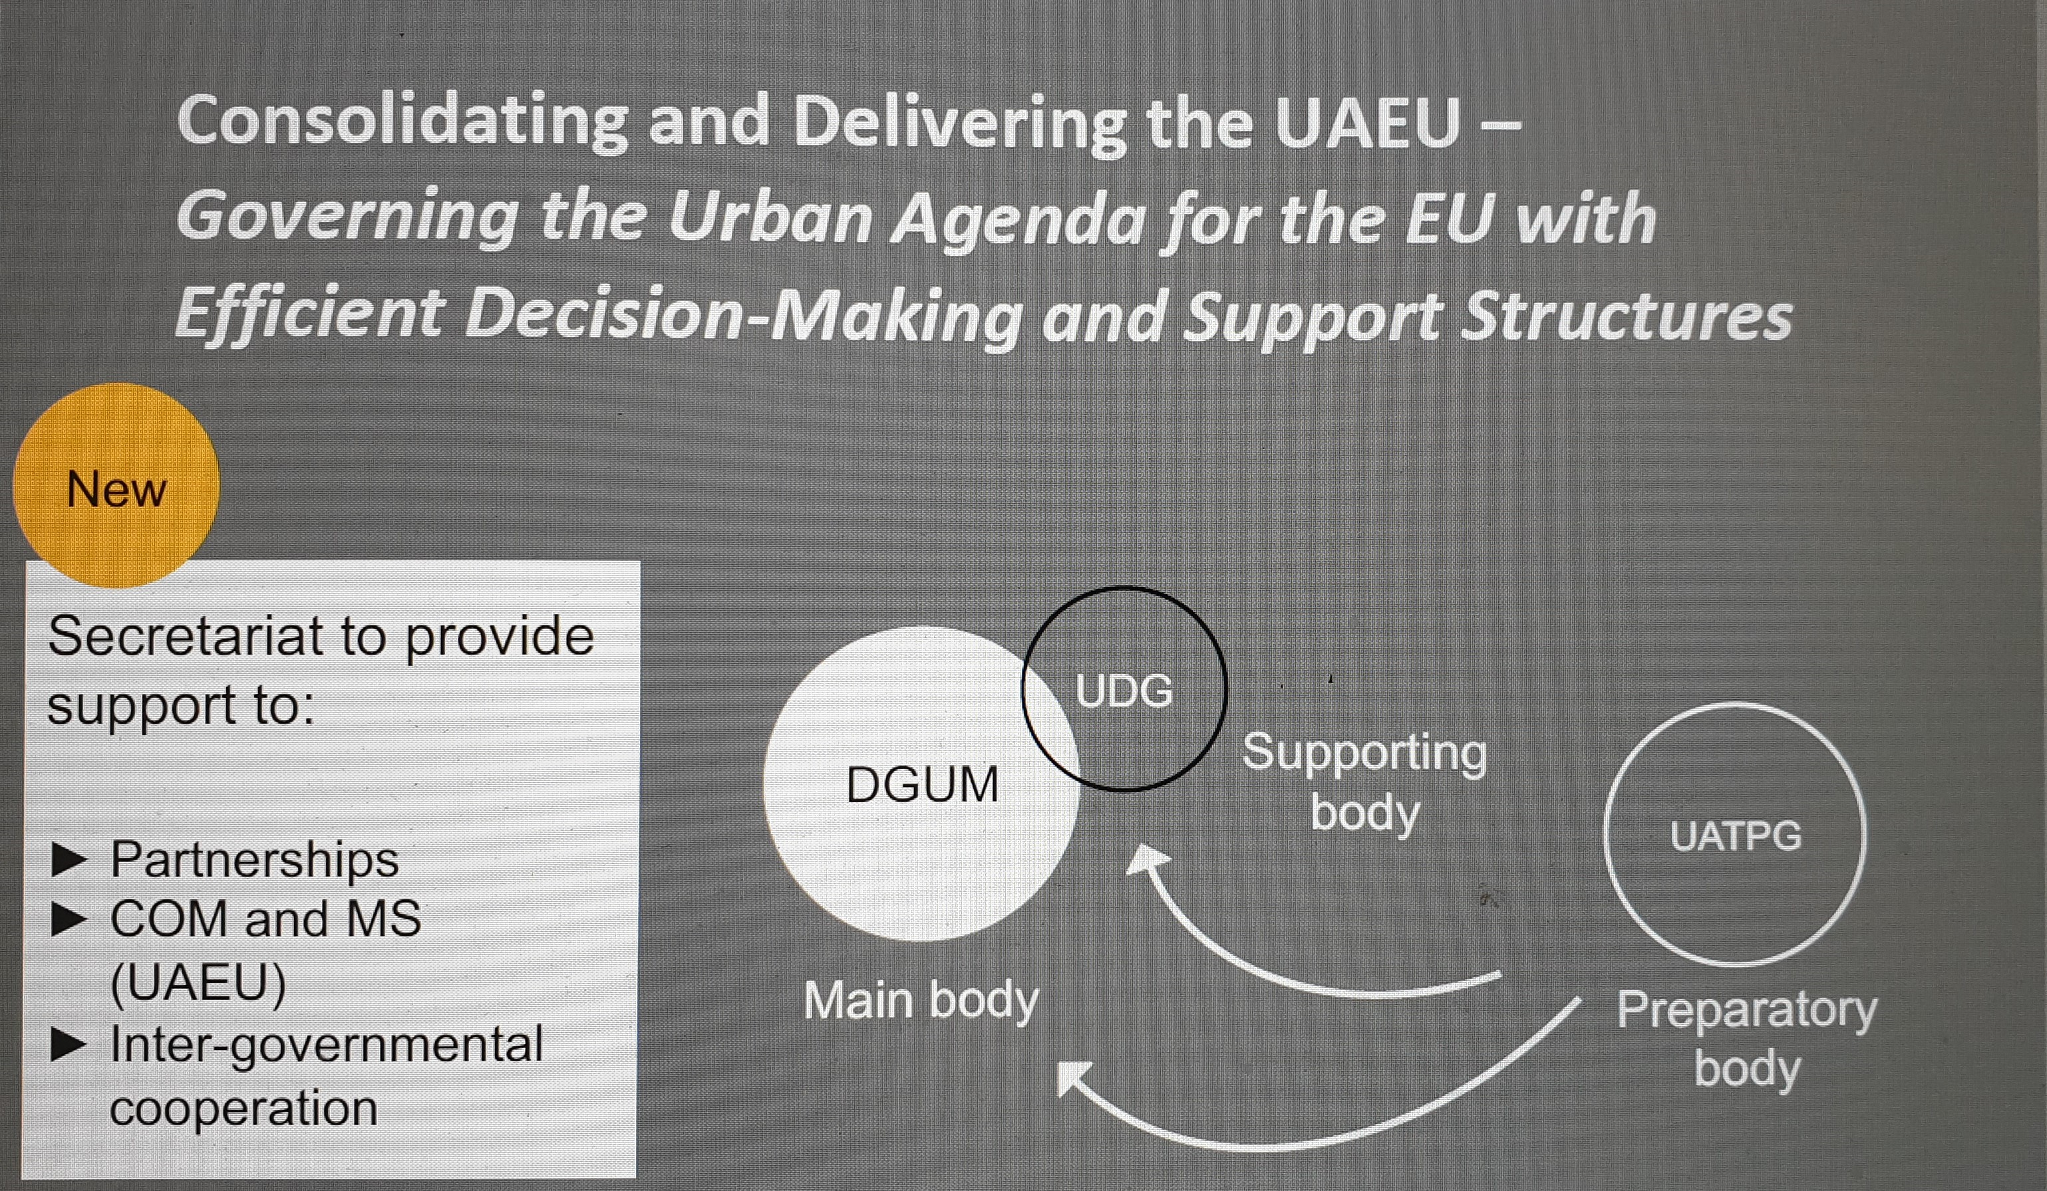
EUI support of the Urban Agenda for the EU and intergovernmental cooperation on urban matters
European dialogue meeting 26 May 2020 – German Presidency presentation on the new Leipzig Charter

Slide 7
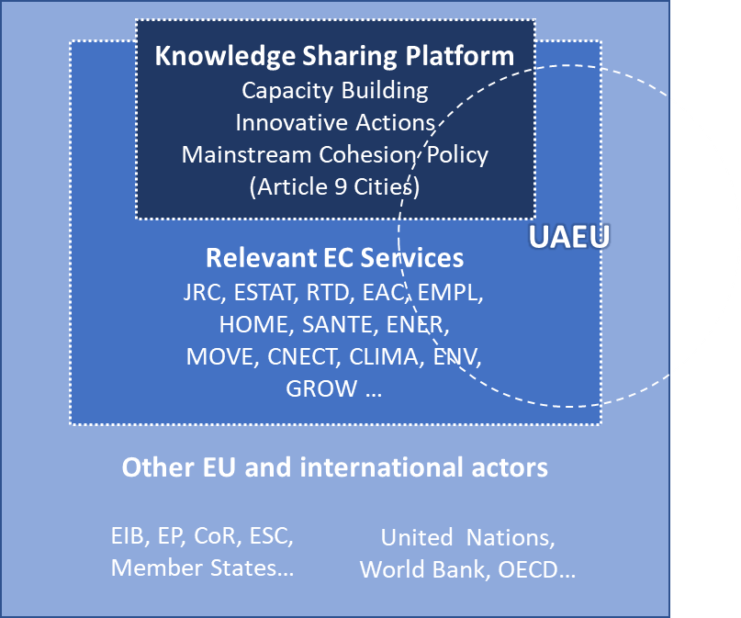
EUI Knowledge Sharing Platform (web-portal)
Specific objectives
  Develop into knowledge base (incl. data) in support of urban policy design & implementation
  Improve access to horizontal & thematic urban knowledge
Main focus
  Capacity building
  Innovative Actions
  Article 9 cities of Cohesion Policy
  Urban Agenda for the EU and its Thematic Partnerships
  The aim is also to interconnect gradually with other urban initiatives of the EU and internationally

Slide 8

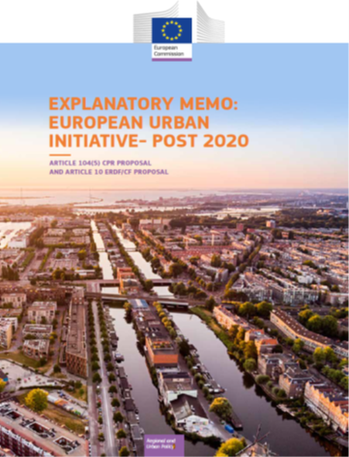


Next steps
European Commission will continue preparatory activities of EUI together with main stakeholders in 2020
  Designing of activities that improve coordination and coherence between the urban support tools of Cohesion Policy
  Dialogue with Member States and other urban actors on how to support the Urban Agenda for the EU and intergovernmental cooperation on urban matters in the frame of EUI (UDG & DGUM meetings in autumn 2020)
  Governance structure of EUI
  Final preparations…

Slide 9
Thank you!
Q&A
Help us assess the UIA Initiative and prepare for the future programming period – surveys open until 5 June 2020 !
Survey open to all:
https://www.surveymonkey.co.uk/r/UIA_Open_Survey
Survey dedicated to UIA beneficiaries:
https://www.surveymonkey.co.uk/r/UIA_Applicant_Survey

