Slide 1

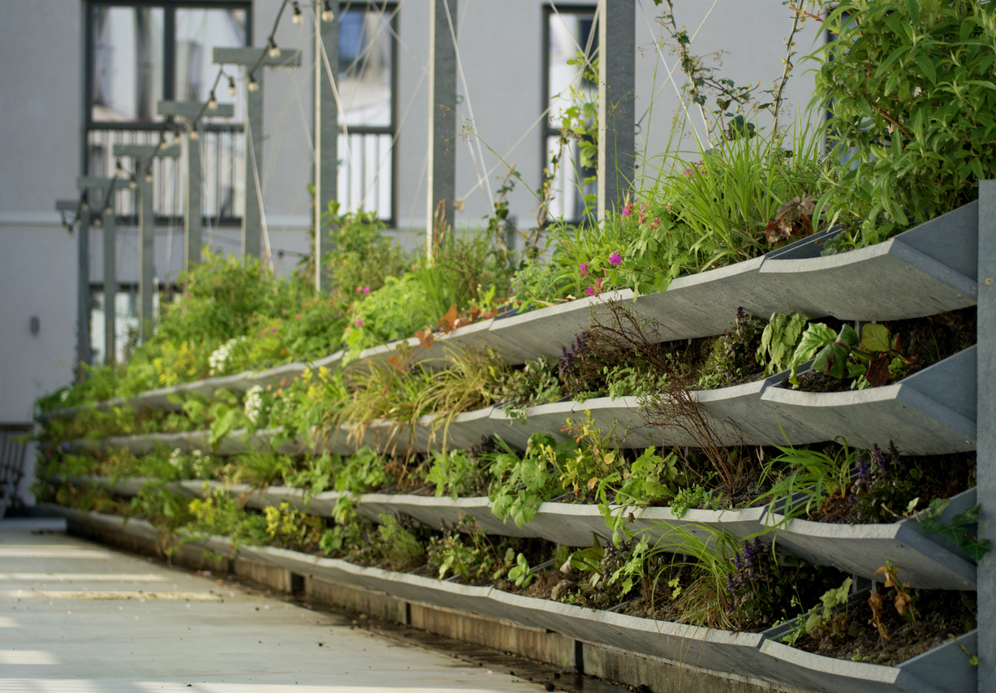

How Much Nature Do We Need in our Cities?
Turning Data into
Urban Greening Action
Marino Cavallo,
Co-Coordinator Greening Cities Partnership
Metropolitan City of Bologna
and NCI
Brussels
15 October 2025

Slide 2
The Urban Agenda for the EU
an Informal Inter-governmental Cooperation
new working method - multi-stakeholder & multi-level cooperation
cities "at the core", Regions, Member states, European Institutions & other stakeholders

Slide 3



The three pillars
Better Regulation
Better Funding
Better Knowledge

Slide 4
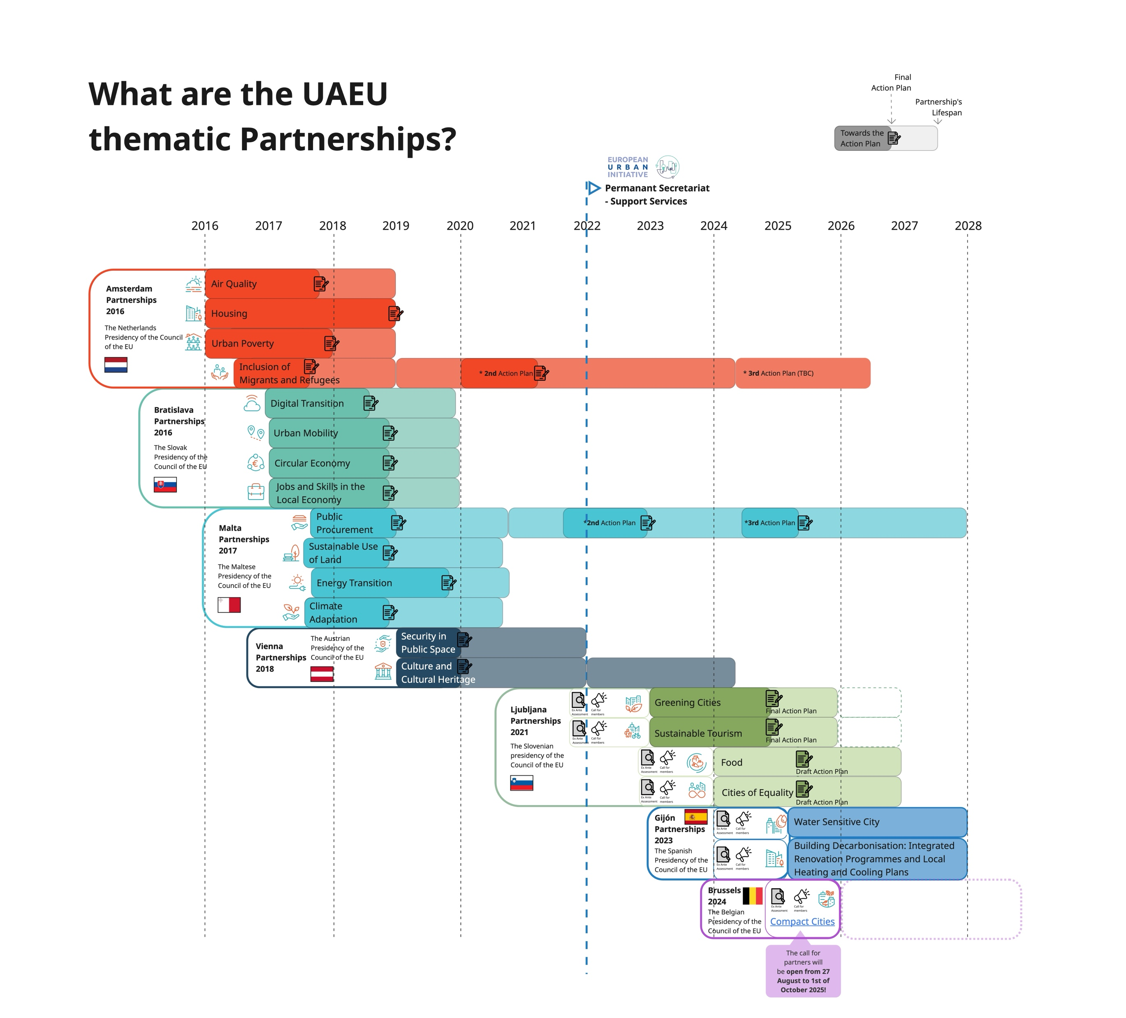
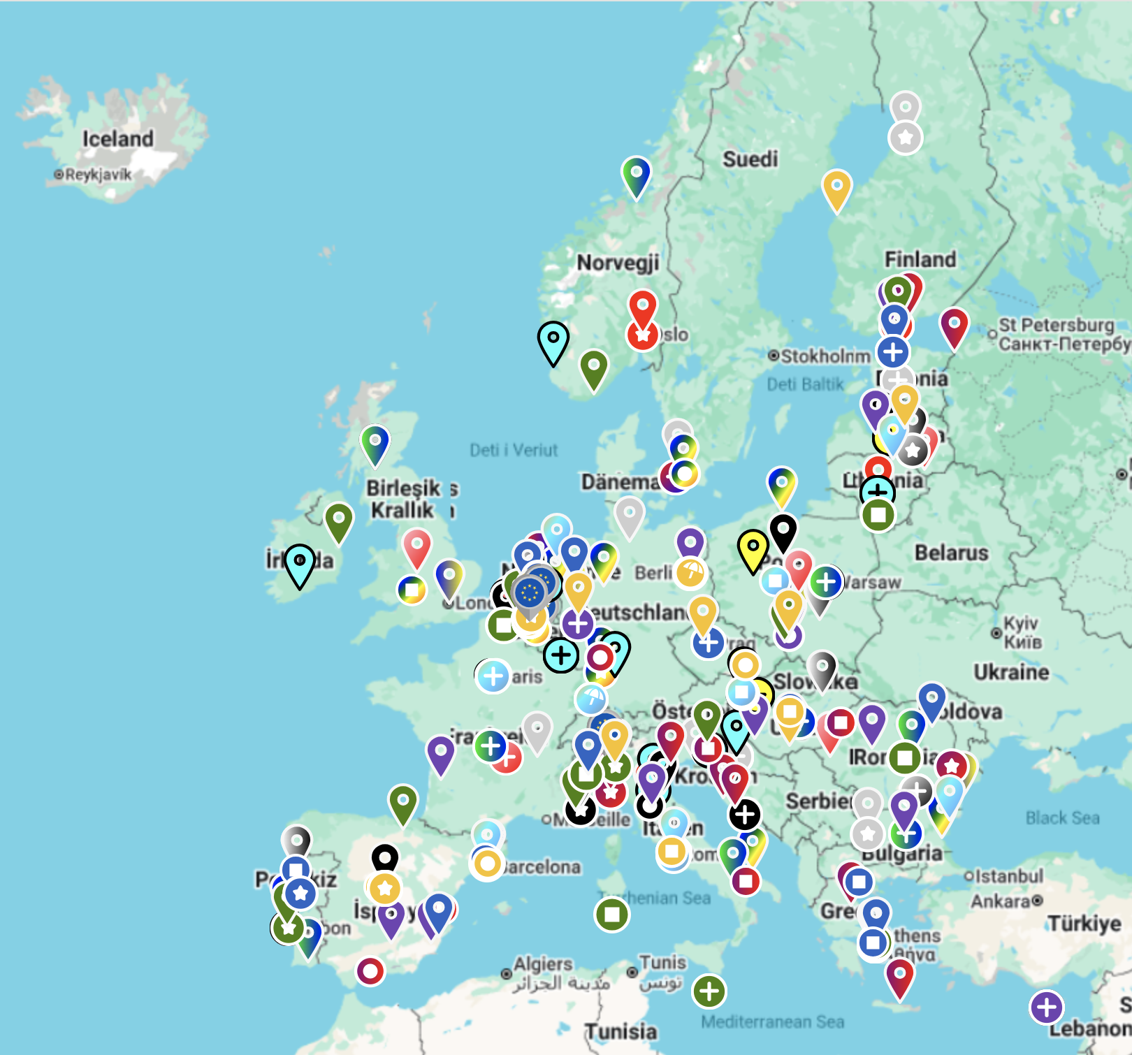
21 Partnerships since 2016

Slide 5
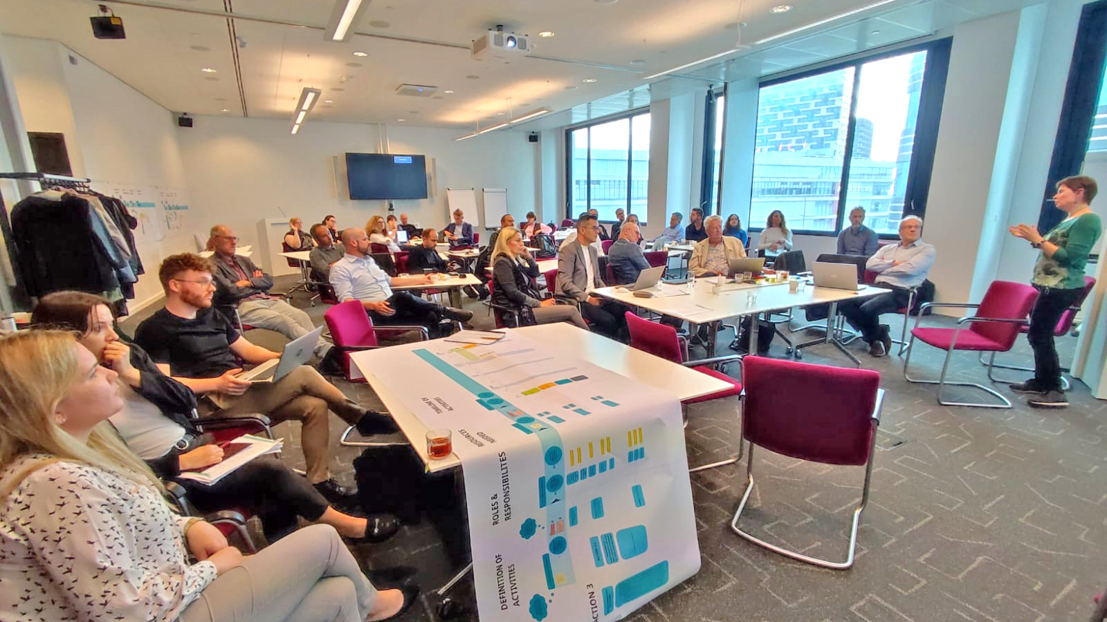

Slide 6
The Greening Cities Partnership
Launched in December 2022
Consists of 32 members
It’s mission is to contribute to the development of an implementation framework for green infrastructure at local, regional/national and EU levels, including the provisions of Article no. 8 of the Nature Restoration Regulation.

Slide 7
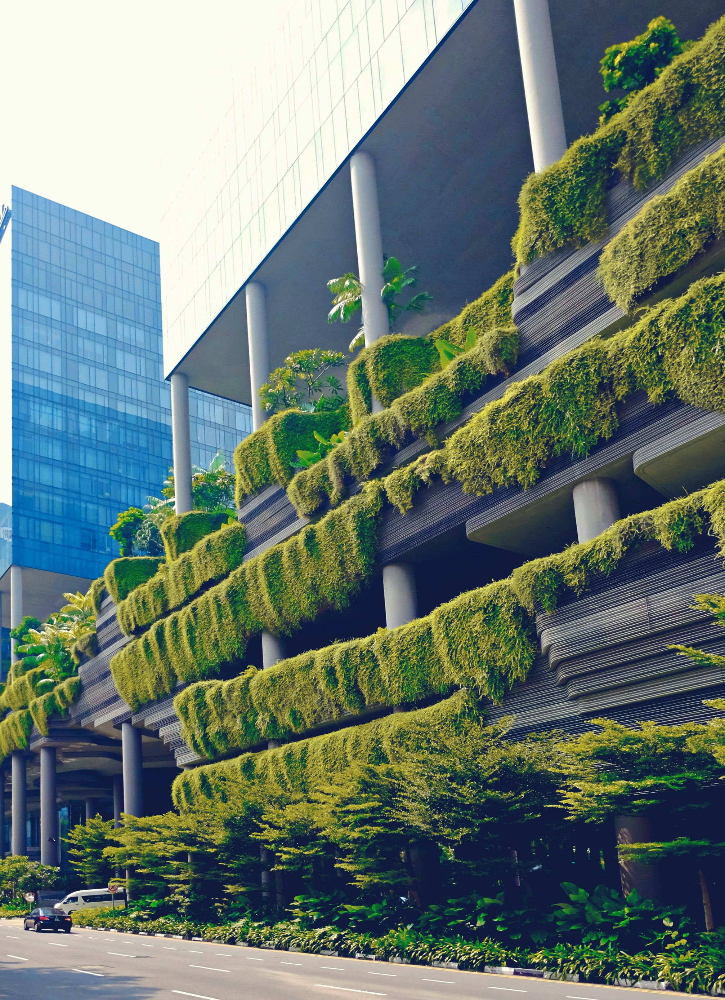
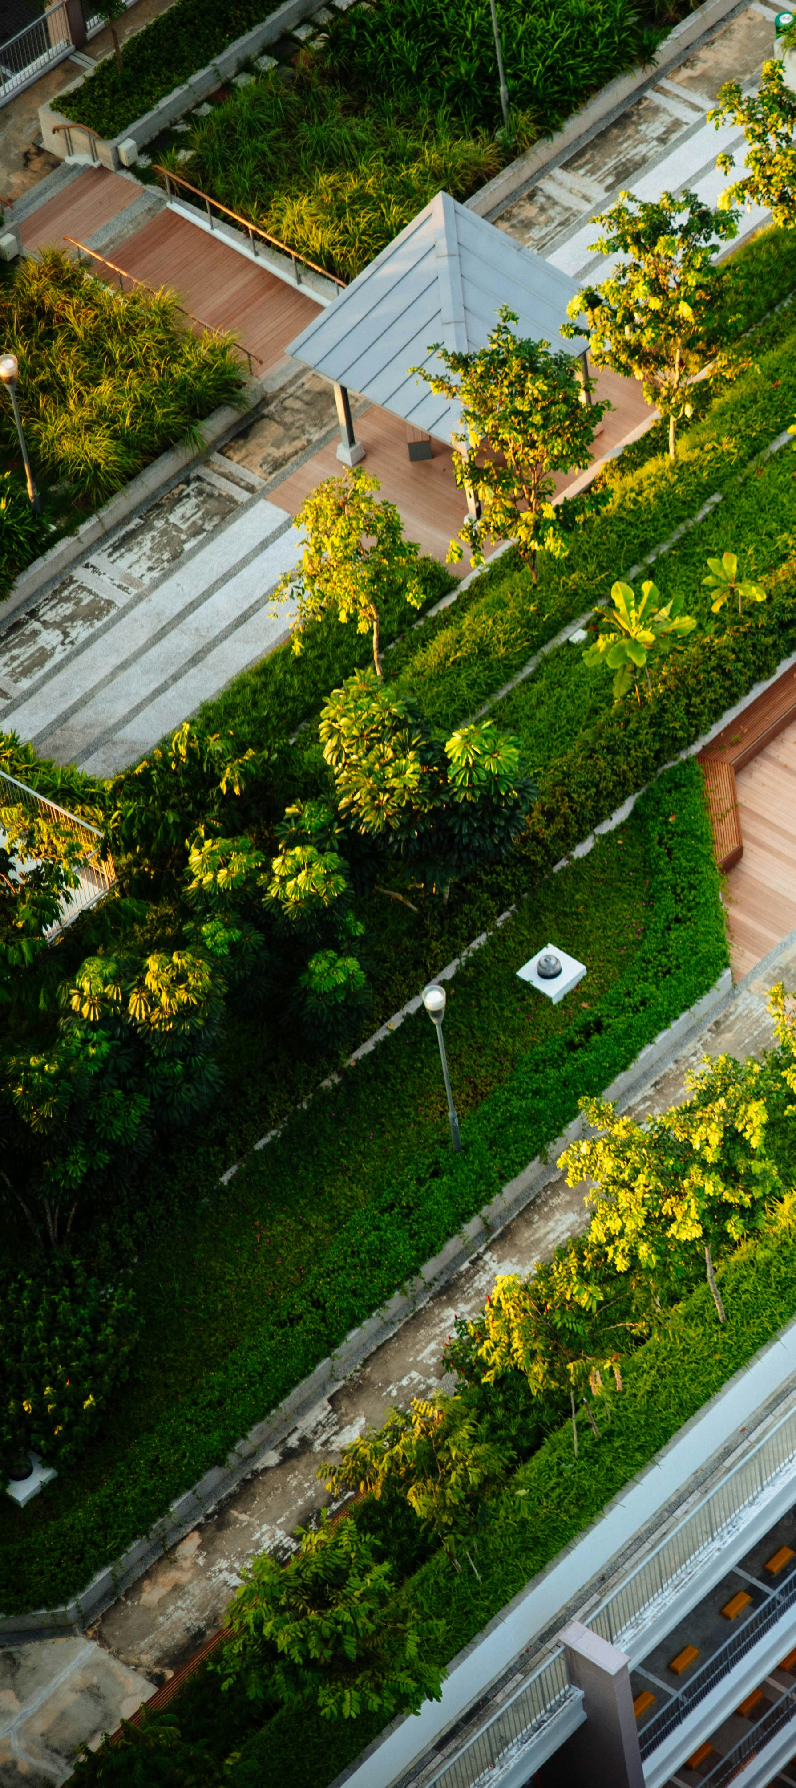
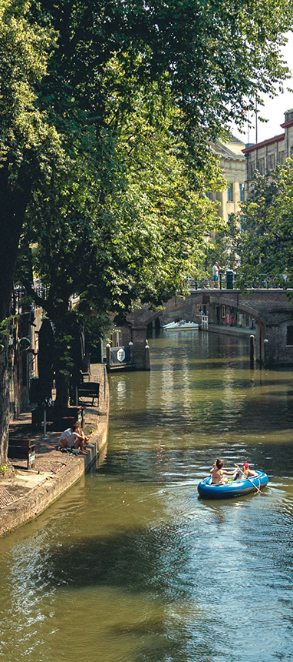
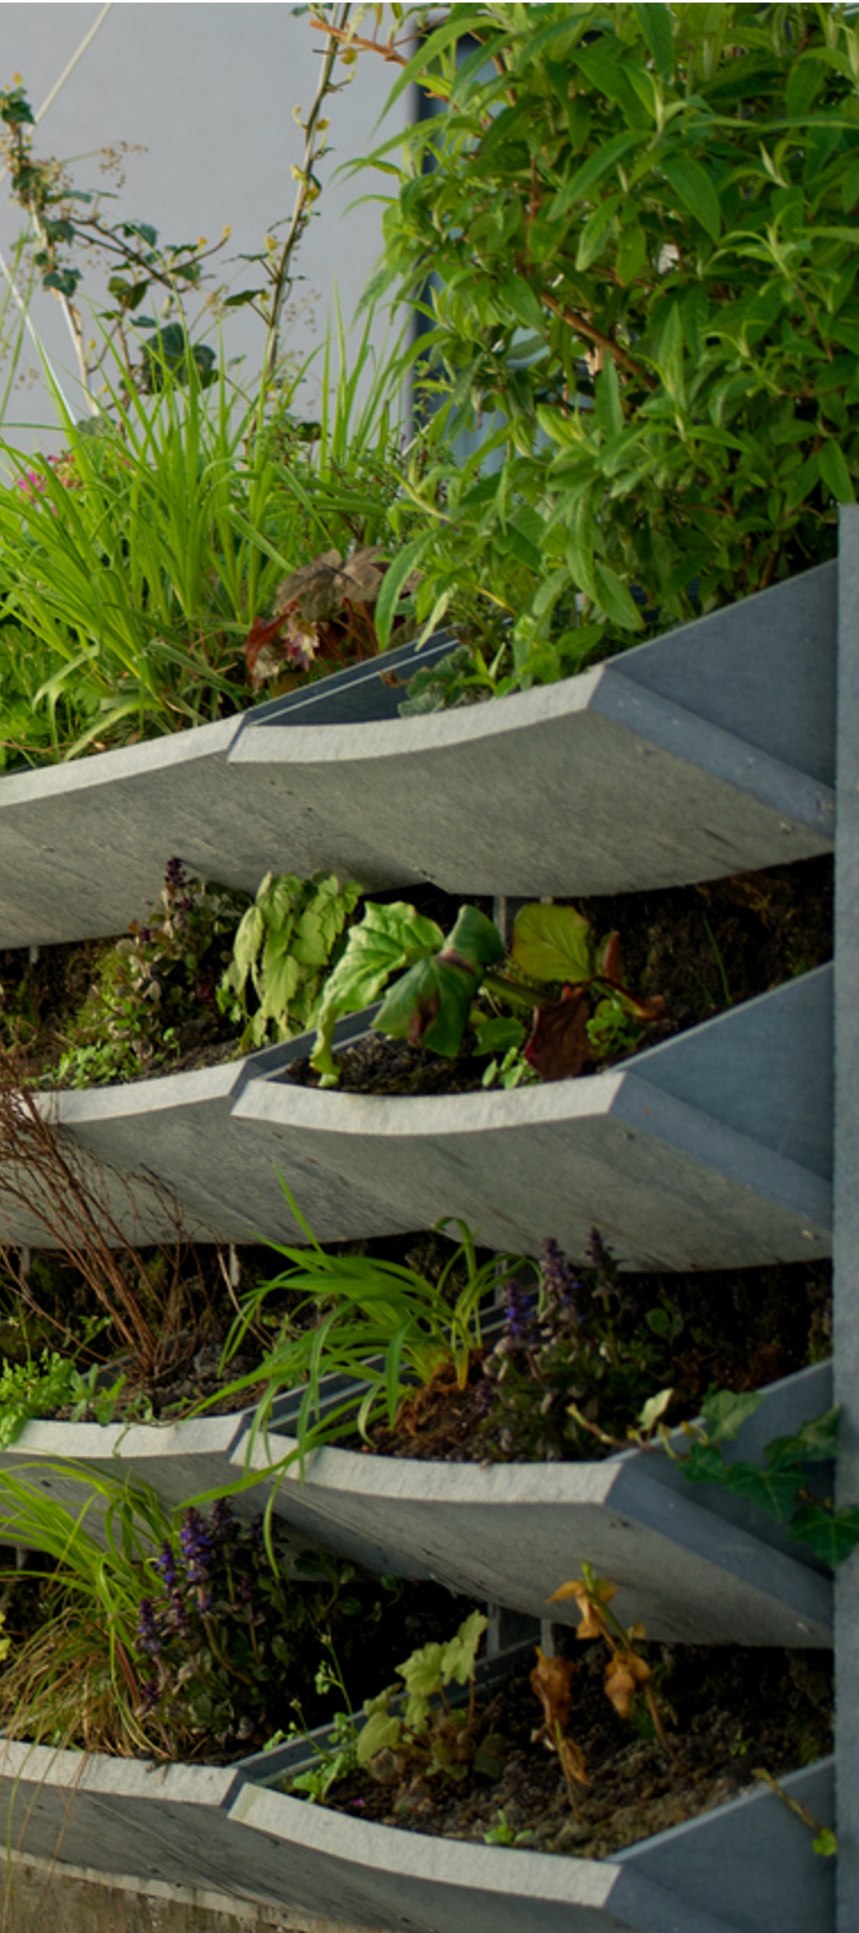

How do we make our cities greener?

Slide 8

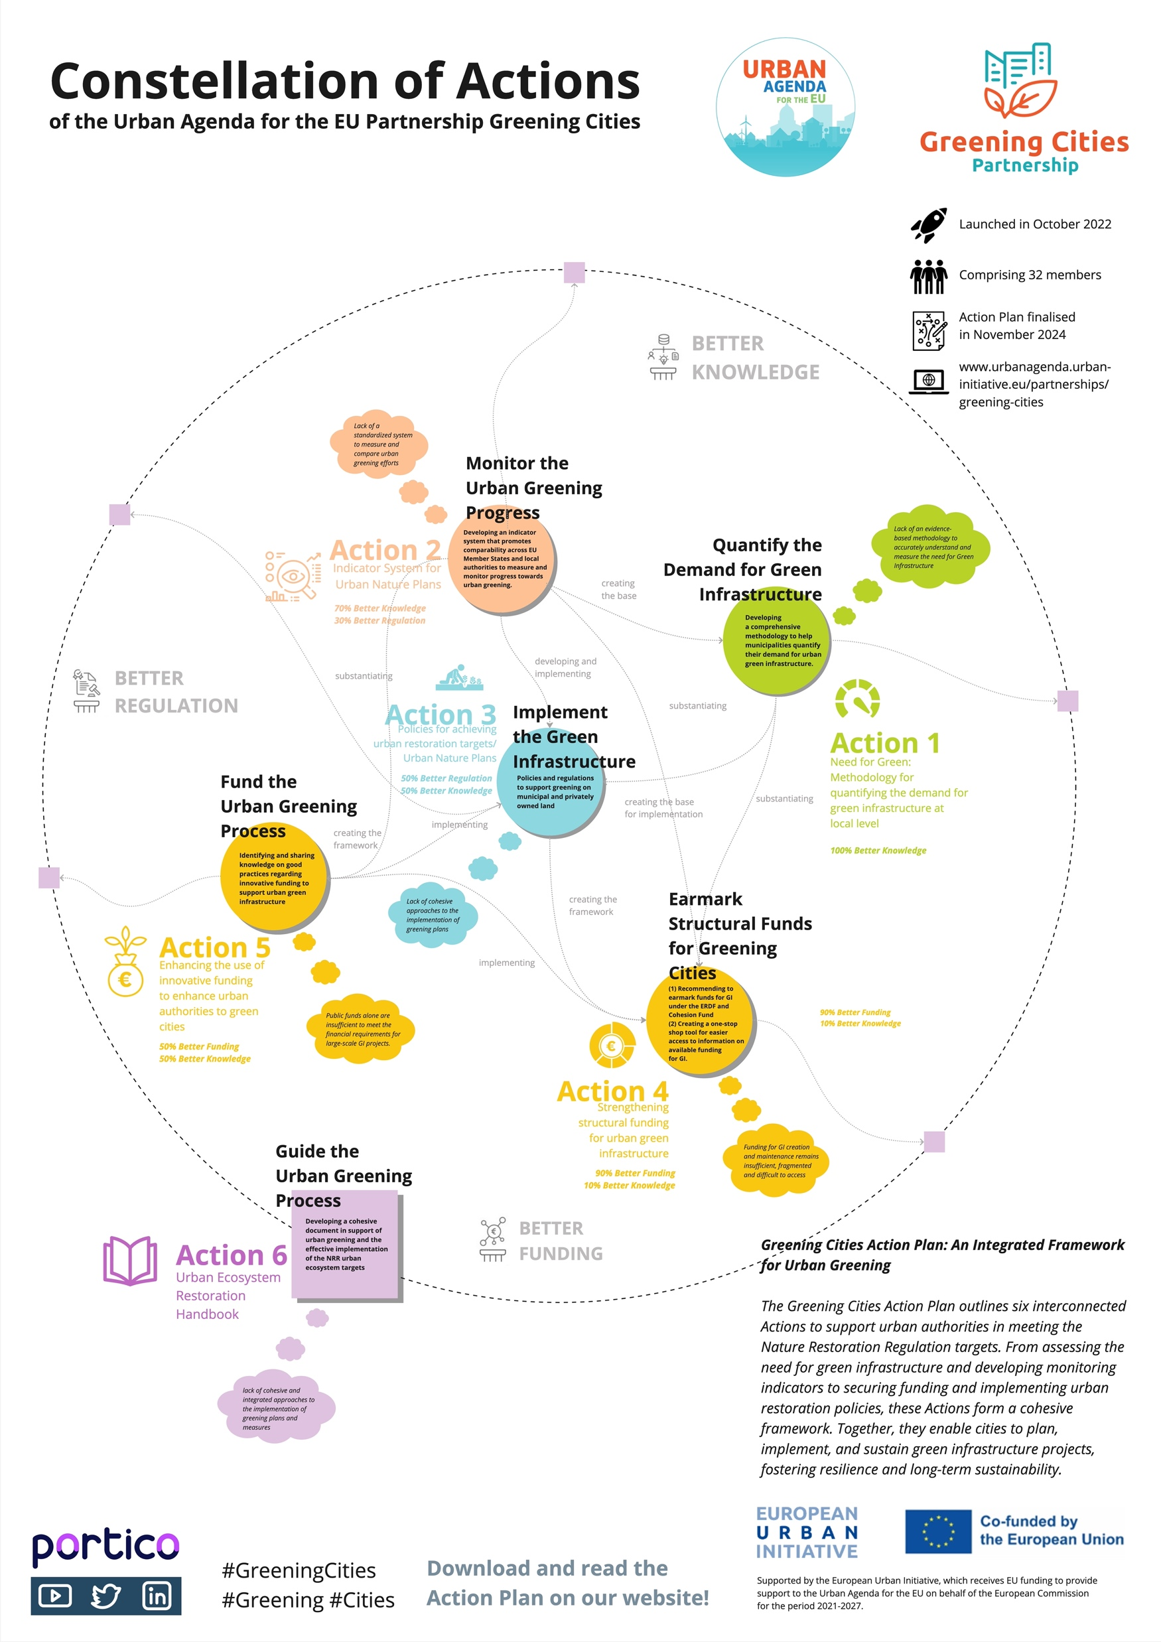

Slide 9

Why are we here?
Reveal a first glimpse of the methodology for quantifying the demand for green infrastructure at local level that is being developed by the Greening Cities Partnership under the ESPON-GILL project;

Slide 10

Why are we here?
Reveal a first glimpse of the methodology for quantifying the demand for green infrastructure at local level that is being developed by the Greening Cities Partnership under the ESPON-GILL project;
Highlight how this methodology sits within the broader EU policy framework (NRR-Article 8, EU Biodiversity Strategy for 2030)

Slide 11

Why are we here?
Reveal a first glimpse of the methodology for quantifying the demand for green infrastructure at local level that is being developed by the Greening Cities Partnership under the ESPON-GILL project;
Highlight how this methodology sits within the broader EU policy framework (NRR-Article 8, EU Biodiversity Strategy for 2030)
Learn from practice: how cities can harness data to assess their need for green;

Slide 12

Why are we here?
Reveal a first glimpse of the methodology for quantifying the demand for green infrastructure at local level that is being developed by the Greening Cities Partnership under the ESPON-GILL project;
Highlight how this methodology sits within the broader EU policy framework (NRR-Article 8, EU Biodiversity Strategy for 2030)
Learn from practice: how cities can harness data to assess their need for green;
Exchange with participants of the workshop to inform the methodology

Slide 13

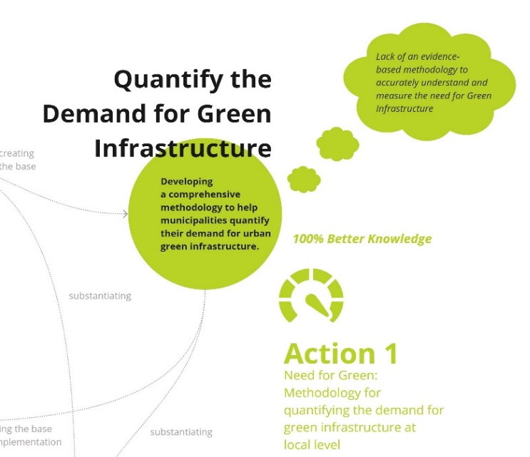


Methodology for quantifying the demand for GI
What constitues green infrastructure at local level?
What benefits does it provide?
How can the current and future demand be practically evaluated at local level?
How can we better informed planning and investment and financial decisions?

Slide 14
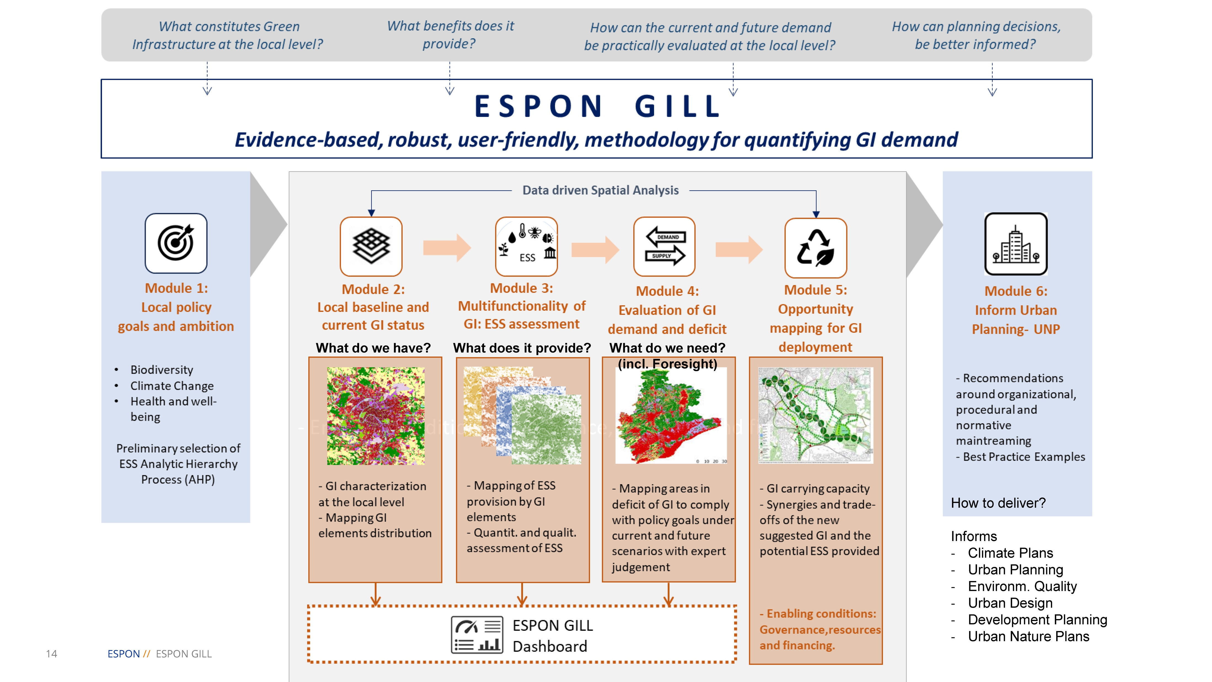
Methodology for quantifying the demand for GI
It provides an evidence-based and scalable tool for cities to assess their green infrastructure needs.
It answers the question: How can evidence guide action?

Slide 15


Join us on Slido
www.slido.com
#greening

Slide 16
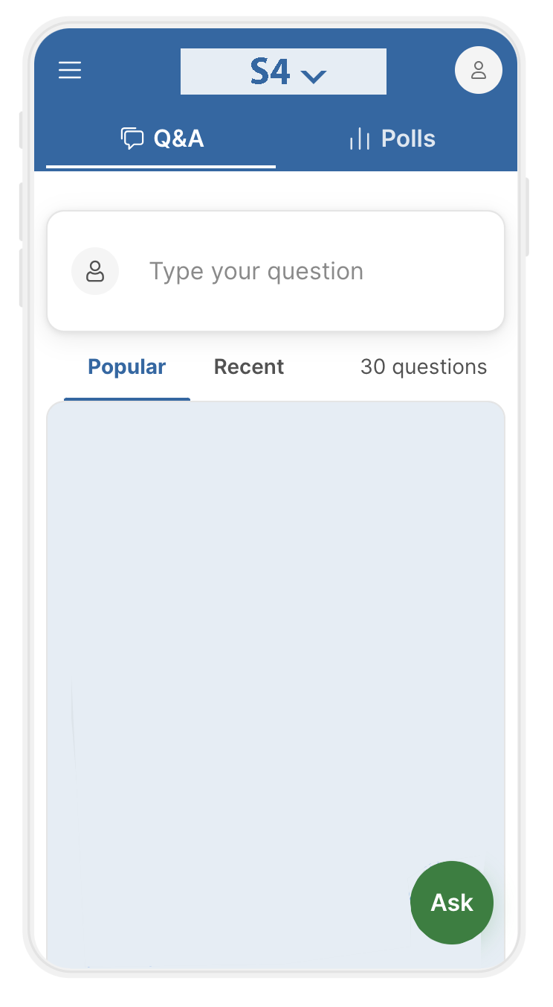
Slido guide

Slide 17
Slido guide
Answer polls
Vote!

Slide 18
Slido guide
Answer polls
Leave your questions

Slide 19
Slido poll #1
What is your city’s biggest challenge when assessing the need for green infrastructure?
www.slido.com
#greening

Slide 20

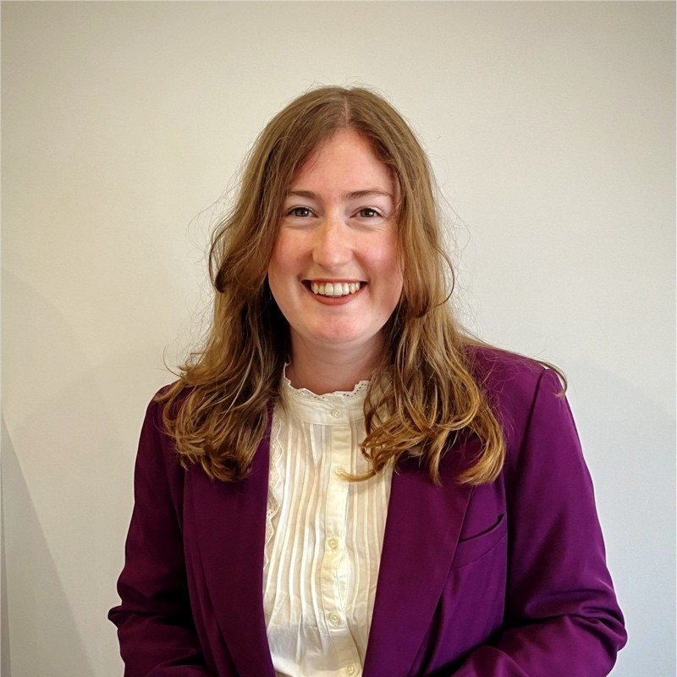

Presentations by invited speakers
Yoann Clouet – Project Manager at the Institute for Urban Excellence, expert at the ESPON GILL consortium.
Bo Vanbesien – Greening Cities Partnership member, City of Roeselare representative.
Paola Lepori – Greening Cities Partnership member, Policy Expert at the ICLEI European Secretariat.

Slide 21



ESPON-GILL Methodology for Quantifying the Demand for Green Infrastructure at Local Level
EWRC 2025 Workshop | How Much Nature Do We Need in our Cities? Turning Data into Urban Greening Action
15 October 2025

Slide 22

About the ESPON GILL Project
Deliver an evidence-based, scientifically robust, scalable, and user-friendly methodology to guide policymakers and practitioners in quantifying the demand for green (and blue) infrastructure at the local level
At its core the GILL methodology aims to map the gap between ecosystem service supply and human / ecosystem needs.
The GILL methodology should tell where nature is “working” for the city, and where the city needs more nature to “work” for it.
22
ESPON GILL

Slide 23
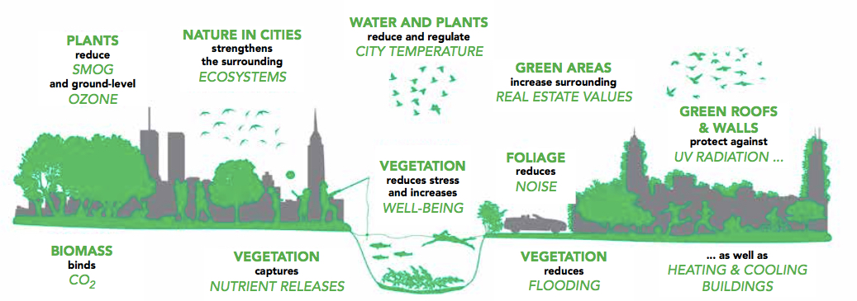
How to quantify the services provided by green infrastucture?
We can measure what Green Infrastructure provides using the Ecoystem Service Assessment approach
Provisioning
Provisioning
Regulating
Cultural
Supporting
Image: C/O City
23
ESPON GILL

Slide 24
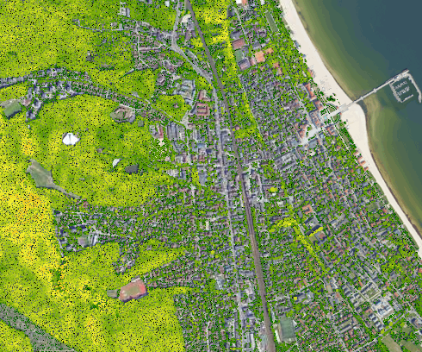
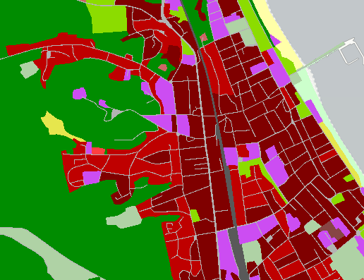
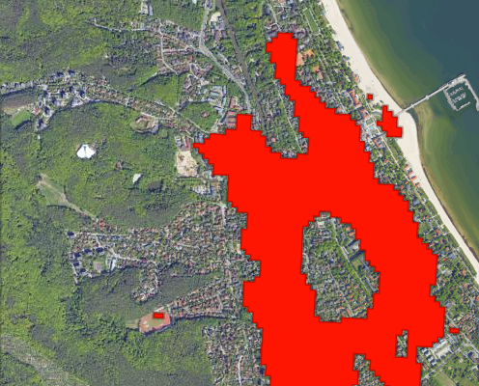
Using data to quantify ecosystem services provision and demand
How much ecosystem services are currently being provided by existing green and blue infrastructure?
Environmental, socio-demographic and spatial data
WHERE IS THE DEMAND UNMET?
What services do people and ecosystems in a city need most, and where?
We can identify areas where more thermal regulation is need to avoid heat islands
Using local tree inventory, we can use a model to infer the thermal regulation they currently provide
24
ESPON GILL

Slide 25
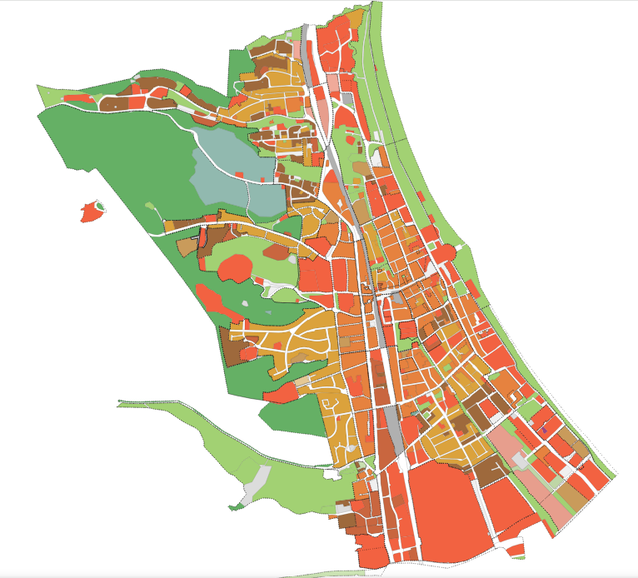

Integrating the demand into urban planning
Different GI for different ESS needs
WHAT TYPE(S) OF GI CAN BE DEVELOPPED?
WHERE IS THE DEMAND UNMET?
INFORM URBAN PLANNING
Inform Nature Restoration effort in urban ecosystems (art.8 NRL)
Form the basis of urban nature plan
Support funding request
WHERE CAN GI REALISTICALLY BE DEVELOPPED?
25
ESPON GILL
Not possible in all areas

Slide 26



Testing the methodology
Funding of ESPON GILL: a Targeted Analysis to develop and test a methodology to quantify the demand for green infrastructure at the local level
Finland
Tampere
Developing and testing the GILL methodology with six case-studies
Developping data inventory for relevant environmental, spatial and socio-demographic data
Poland
Sopot
Belgium
Roeselare
Romania
Târgu Mureș
Croatia
Jastrebarsko
Italy
Imola
26
ESPON GILL

Slide 27
What data to quantify the demand for green infrastructure?
Spatial and statistical datasets (e.g., land use, biodiversity, socio-economic indicators): often fragmented across institutions, difficult to access, or not collected at the appropriate scale for urban-level GI planning.
Datasets may lack sufficient spatial resolution, granularity, or temporal consistency to assess ecosystem service supply and demand at the relevant city scale
ESPON GILL focused on local data sources (municipal) and proposes proxy sources from EU level data sources (CORINE Land Cover, EEA soil maps, WISE, etc.)
27
ESPON GILL

Slide 28
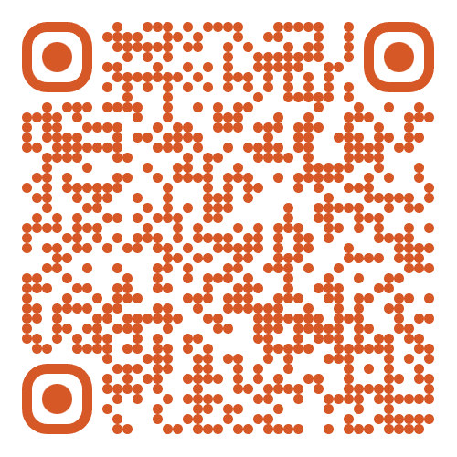
How to inform urban planning? We are looking for Good Practices
SCAN THE QR CODE
We are collecting examples of planning documents by local authorities relevant to green infrastructure.
urban nature plan
green infrastructure plan
urban forestry plan
climate adaptation plan
urban biodiversity strategy
spatial development plan with a focus on green infrastructure
Etc.
Selected plans will be included in a repository of good practices, serving as inspiration and guidance for other cities and towns developing green infrastructure and urban nature plans.
28
ESPON GILL

Slide 29
THANK YOU
clouet@institute-urbanex.org

Slide 30
Slido poll #2
www.slido.com
#greening

Slide 31
Slido poll #2
Which of the following questions would you like the speakers to explore further? Rank the questions.
www.slido.com
#greening

Slide 32
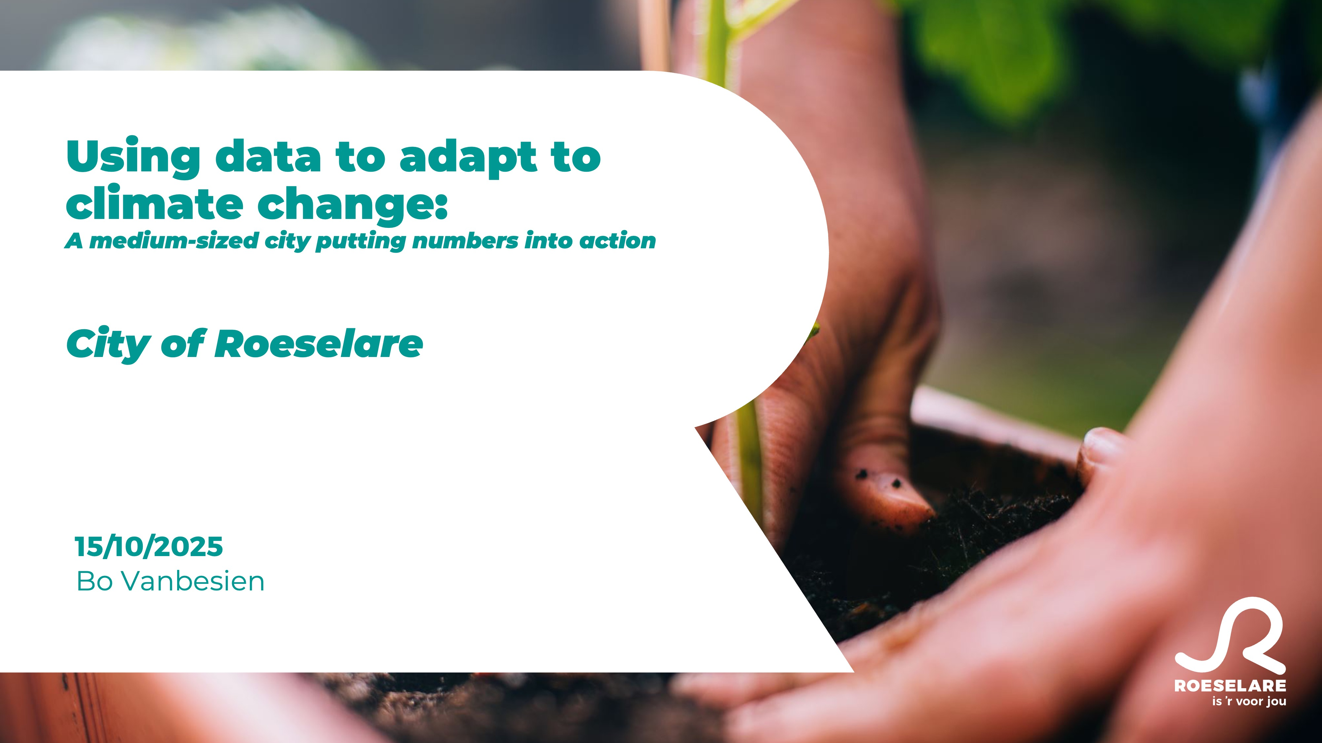

Slide 33
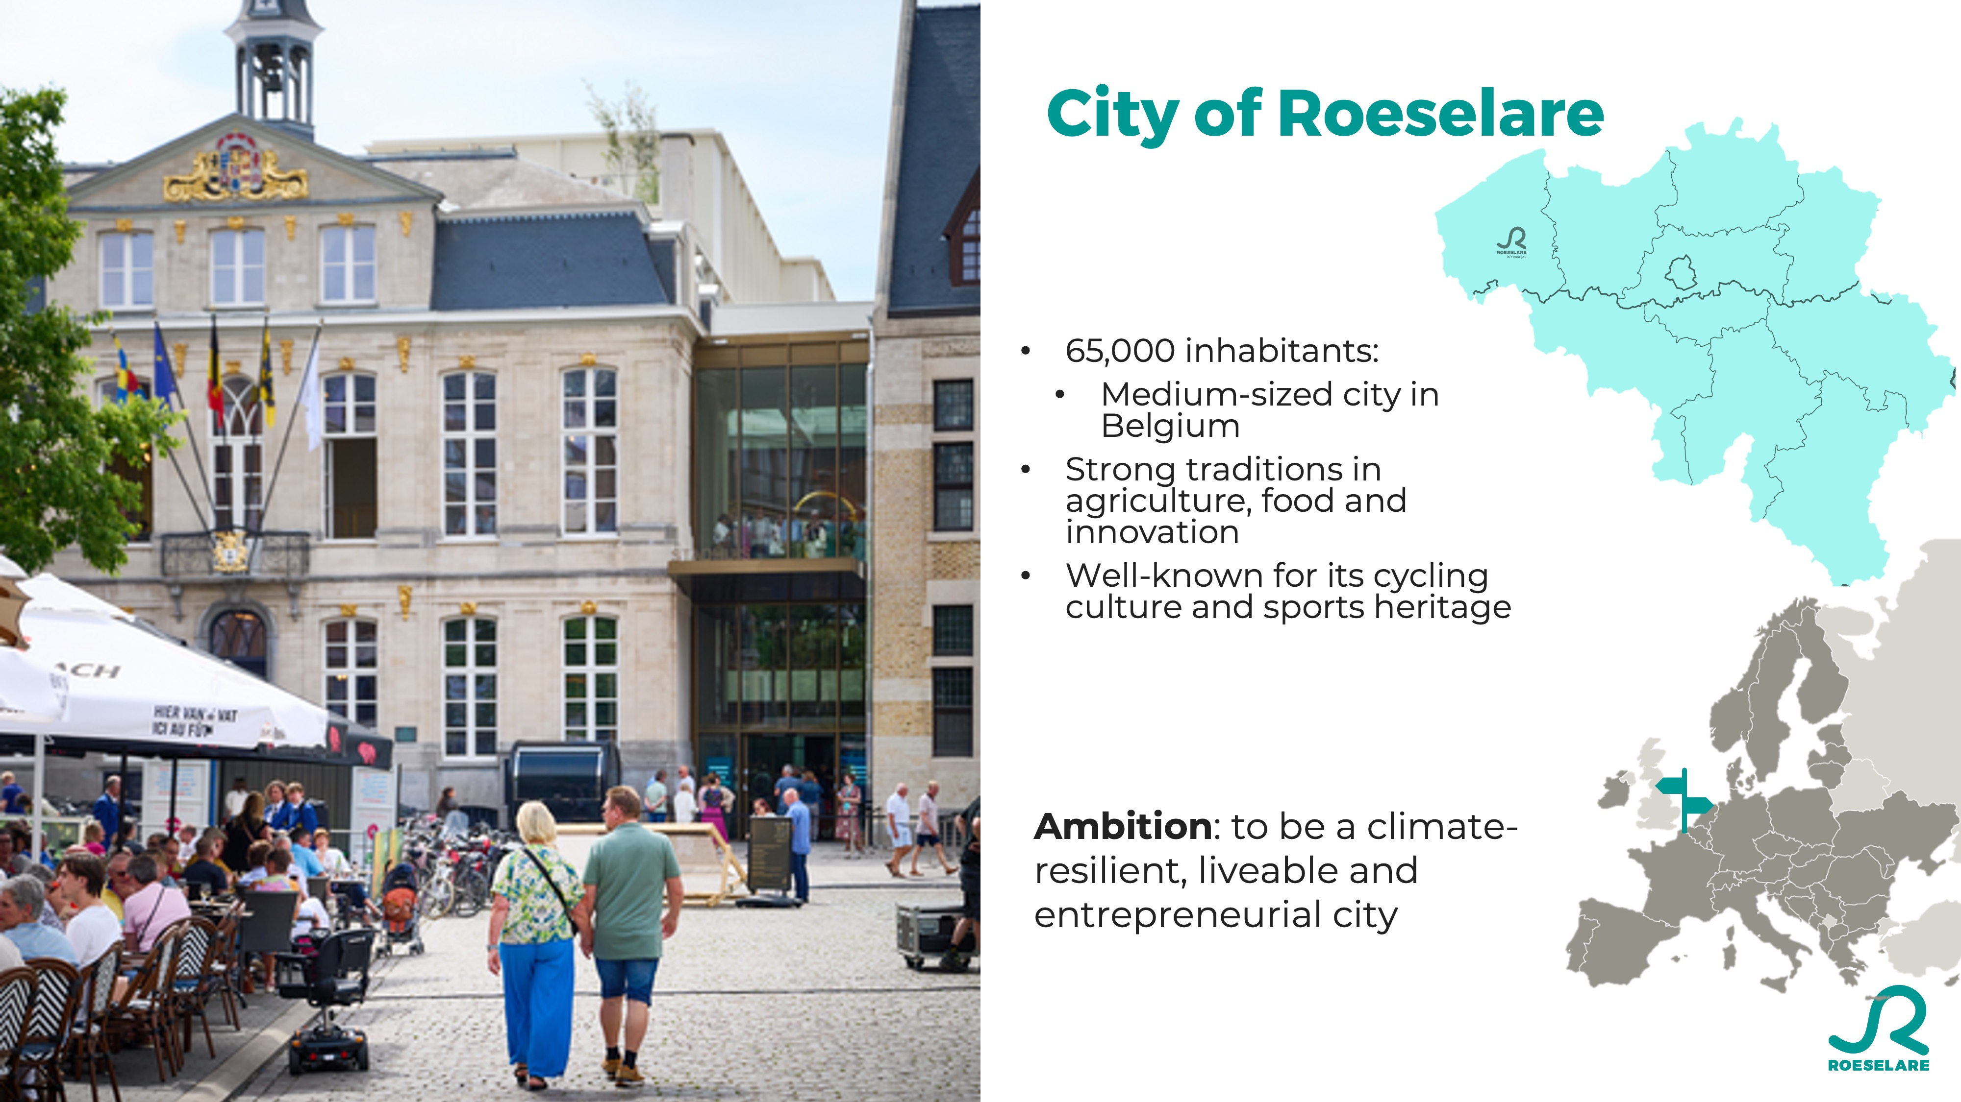

Slide 34
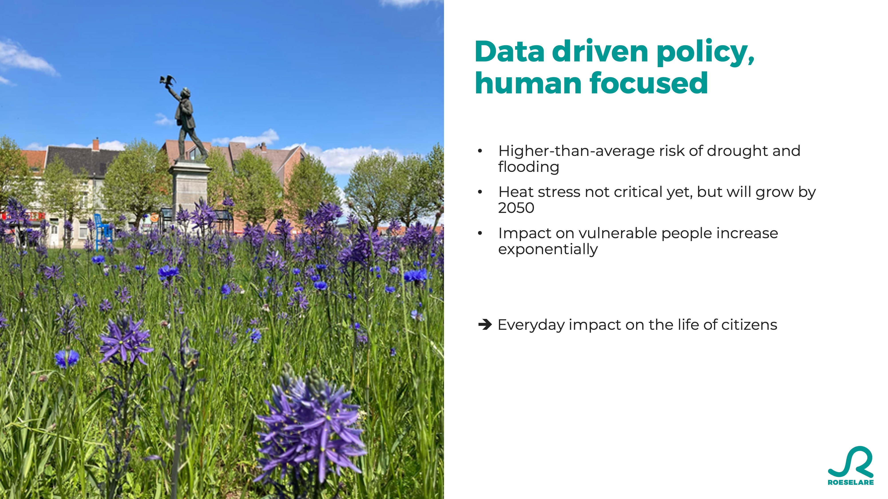

Slide 35
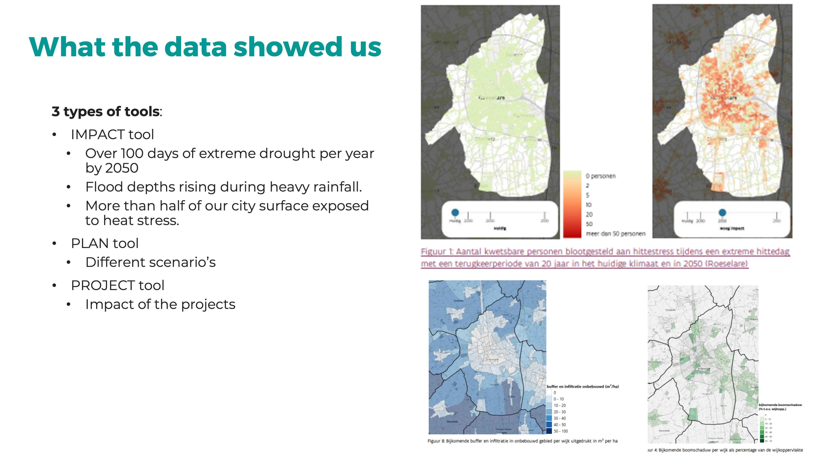

Slide 36
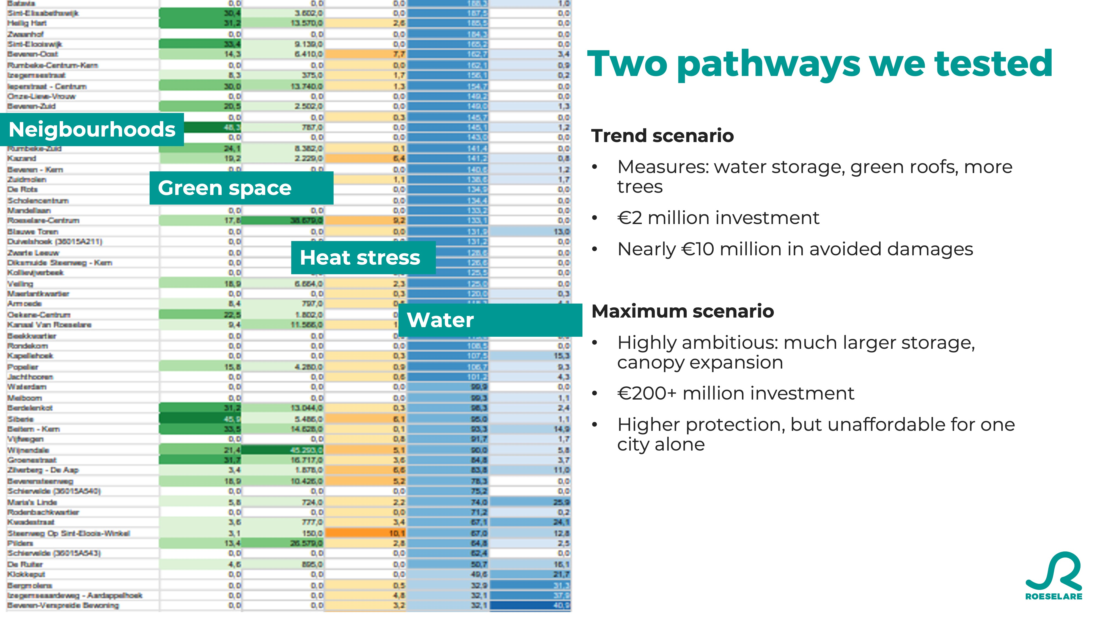

Slide 37
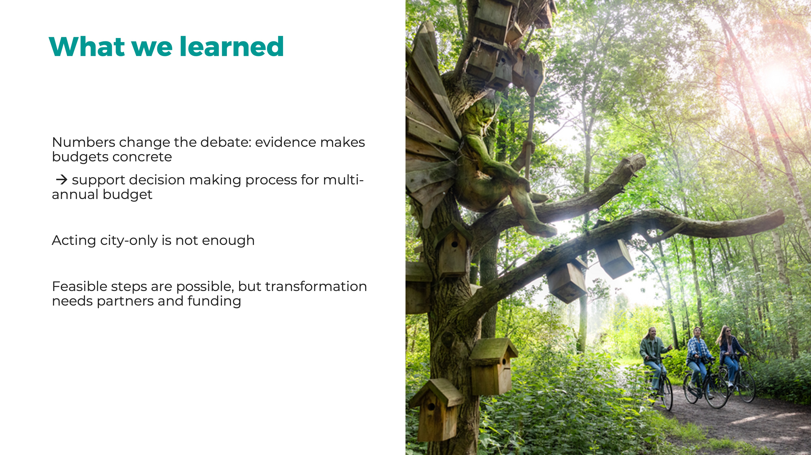

Slide 38


Slide 39
Slido poll #2
Which of the following questions would you like the speakers to explore further? Rank the questions.
www.slido.com
#greening

Slide 40
Paola Lepori, Senior Expert Biodiversity & Nature-based Solutions, ICLEI Europe

Slide 41
Why green infrastructure matters
Cities worldwide face heat, flooding, biodiversity loss.
Green infrastructure is no longer optional: it’s essential for resilience, health, and climate neutrality.
The challenge now: scaling and embedding GI in governance and finance.
15/10/2025
41

Slide 42
Europe’s leadership
EU strategies: Biodiversity Strategy, Climate Adaptation, Nature Restoration Regulation (NRR).
ICLEI helps shape and implement these frameworks.
Examples: Berlin Urban Nature Pact (ambitious biodiversity targets) + UNP+ project (practical planning tools).
15/10/2025
42

Slide 43
A global movement
From sponge cities in China to urban restoration in Latin America, GI is spreading.
Next milestone: CBD COP-17 in Armenia → cities’ voices matter, ICLEI will lead Cities Summit.
15/10/2025
43

Slide 44
Financing the transition
Scaling GI requires investment.
ICLEI exploring “nature markets” to pool resources and de-risk projects.
Goal: shift from pilots to systemic implementation.
15/10/2025
44

Slide 45
ICLEI’s role & call to action
ICLEI connects local governments to EU and global processes (CitiesWithNature, NetworkNature).
Mission: ensure cities have the tools, resources, and influence to make GI a pillar of climate-neutral, resilient, and just cities.
Reflection: Now is the moment to turn ambition into lasting transformation.
15/10/2025
45

Slide 46
5 ICLEI Pathways

Slide 47
ICLEI around the World

Slide 49
Thank you!

Slide 50
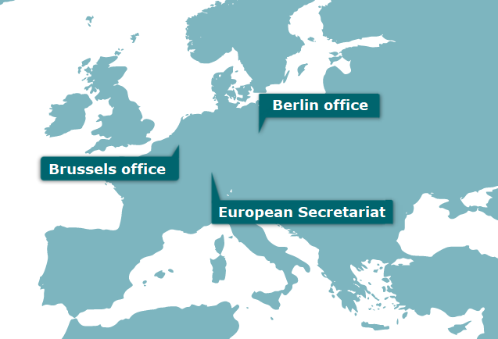
Contact us
paola.lepori@iclei.org

Slide 51
Slido poll #2
Which of the following questions would you like the speakers to explore further? Rank the questions.
www.slido.com
#greening

Slide 52
How do we make our cities greener?

Slide 53
Interactive discussion with invited speakers
Yoann Clouet – Project Manager at the Institute for Urban Excellence, expert at the ESPON GILL consortium.
Bo Vanbesien – Greening Cities Partnership member, City of Roeselare representative.
Paola Lepori – Greening Cities Partnership member, Policy Expert at the ICLEI European Secretariat.

Slide 54
Questions for the audience
What is missing in current methods to quantify GI demand?
What support would help you turn data into action?

Slide 55
Leave your contact details
www.slido.com
#greening

Slide 56

Head to
News & Events
for opportunities to get involved
Here’s where we’ll include updates on the methodology and workshops where you can input into Greening Cities Partnership Actions.

Slide 57




Thank you for your attention!
marino.cavallo@cittametropolitana.bo.it
www.urbanagenda.urban-initiative.eu
@EUUrbanAgenda
@Urban Agenda for the EU

